Slide 1


Android Internals

Slide 2

Table of Contents
Introduction to Android System Programming: 4
Setting Up the Development Environment: 28
Discovering Kernel, HAL, and Virtual Hardware: 65
Customizing the Android Emulator: 102
Enabling the ARM Translator and Introducing Native Bridge: 149
Debugging the Boot Up Process Using a Customized ramdisk: 214
Enabling Wi-Fi on the Android Emulator
Creating Your Own Device on VirtualBox
Booting Up x86vbox Using PXE/NFS

Slide 3
Table of Contents
10. Enabling Graphics
11. Enabling VirtualBox-Specific Hardware Interfaces
12. Introducing Recovery
13. Creating OTA Packages
14. Customizing and Debugging Recovery

Slide 4
Introduction to Android System Programming

Slide 5
Introduction to Android System Programming
In summary, we will cover the following topics in this lesson:
Introduction to Android system programming
Overview of the Android system architecture
Introduction to the third-party projects used in this course
Introduction to virtual hardware platforms
Notes:
Introduction to Android System Programming
This course is about Android system programming. In this lesson, we will start with a discussion on system programming and the scope of Android system programming (to give a high-level view of this course). After that, we will look at the Android system architecture. From the architecture, we can see the layers that we will focus on in this course. We will also talk about the virtual hardware platforms and third-party open source projects that we will use in this course.

Slide 6
What is system programming?
When we talk about what system programming is, we can start with the definition of system programming in Wikipedia:
"System programming (or systems programming) is the activity of programming system software. The primary distinguishing characteristic of systems programming when compared to application programming is that application programming aims to produce software which provides services to the user (e.g. word processor)
Notes:
whereas systems programming aims to produce software and software platforms which provide services to other software, are performance constrained, or both (e.g. operating systems, computational science applications, game engines and AAA video games, industrial automation, and software as a service applications). "
From the preceding definition, we can see that when we talk about system programming we actually deal with the building blocks of the computer system itself. We may depict the system architecture and how it looks like inside the system. As an example, we can refer to system programming books for Windows or Linux. The course Linux System Programming published by O'Reilly Media, Inc. includes topics about file I/O, process management, memory management, interrupt handling, and so on. There is another course called Windows System Programming published by Addison-Wesley Professional that includes very similar topics to its Linux counterpart.
You may expect similar content in this course for Android, but you will find that the topics in this course are quite different from the classic system programming course. First of all, it doesn't really make sense to have a system programming course for Android talk about file I/O, process management, or memory management, because the Linux System Programming course can cover almost the same topics for Android (Android uses Linux kernels and device driver models).
When you want to explore kernel space system programming, you can read books such as Linux Device Drivers by O'Reilly or Essential Linux Device Drivers from Prentice Hall. When you want to explore user space system programming, you can read the course that I mentioned before, Linux System Programming by O'Reilly. Then you may wonder, Do we need an Android System Programming course in this case? To answer this question, it depends on how we look at system programming for Android. Or in other words, it depends on which angle we look at Android System Programming from. We can tell people different things about the same world from different perspectives. In that sense, we may need more than one course to talk about Android system programming.
To talk about Android system programming, we can talk about it theoretically or practically. In this course, we will do it practically with a few actual projects and hands-on examples. Our focus will be how to customize the Android system and how to port it to a new platform.

Slide 7
What is the scope of this course?
As we know, there are two kinds of programming for Android: application programming and system programming.
Usually, it is hard to draw a line between system programming and application programming, especially for C language-based operating systems, such as Linux and all kinds of Unix system.
With the Android framework, the application layer is separated nicely from the rest of the system.
Notes:
You may know that Android application programming uses the Java language and Android system programming using Java, C/C++, or assembly languages. To make it simple, we can treat everything other than application programming in the Android world as the scope of system programming. In this sense, the Android framework is also in the scope of system programming.
From the perspective of the audiences of this course, they may want to learn more about the layers they may touch on in their project work. The Android framework is a layer that will be changed by Google only in most cases. From this point of view, we won't spend too much time talking about the framework itself. Instead, we will focus on how to port the system including the Android framework from the standard platforms in Android Open Source Project (AOSP) to other platforms. We will focus on the layers that need to be changed during the porting process in this course.
After we have done the porting work, a new Android system will be available. One thing that we need to do for the new system is deliver the changes for the new system to the end users from time to time. It could be a major system update or bug fixing. This is supported by over-the-air (OTA) updates in Android. This is also one of the topics in this course.
Traditionally, all Unix programming was system-level programming. Unix or Linux programming is built around three cornerstones, which are system calls, the C library, and the C compiler. This is true for Android system programming as well. On top of the system calls and C library, Android has an additional layer of abstraction for the Android application level. This is the Android framework and Java virtual machine.
In that sense, most Android applications are built using Android SDK and Java language. You may be wondering whether it is possible to do Android application development using C/C++ or even do system level programming using Java. Yes, all these are possible. Besides Android SDK, we can also develop native applications using Android NDK. There are also a lot of Android framework components developed using the Java language. We can even develop Android applications using C# with Visual Studio (Xamarin). However, we won't go to that kind of complexity in this course. We will focus on the layers below the application framework. Again, the focus will be on customizing and extending the existing system or porting the entire system to a new hardware platform.
The reason why we will focus on the porting of Android systems and the customization of Android systems is because these are what most people working on the Android system level will do. After Google releases a new version of Android, silicon vendors need to port the new version to their reference platform. When OEM/ODM companies get the reference platform, they have to customize the reference platform to their products. The customization includes the build of the initial system itself and the deployment of the updates to the deployed system. In the first part of this course, we will discuss the porting of Android systems. In the second part of this course, we will discuss how to update the existing system.

Slide 8
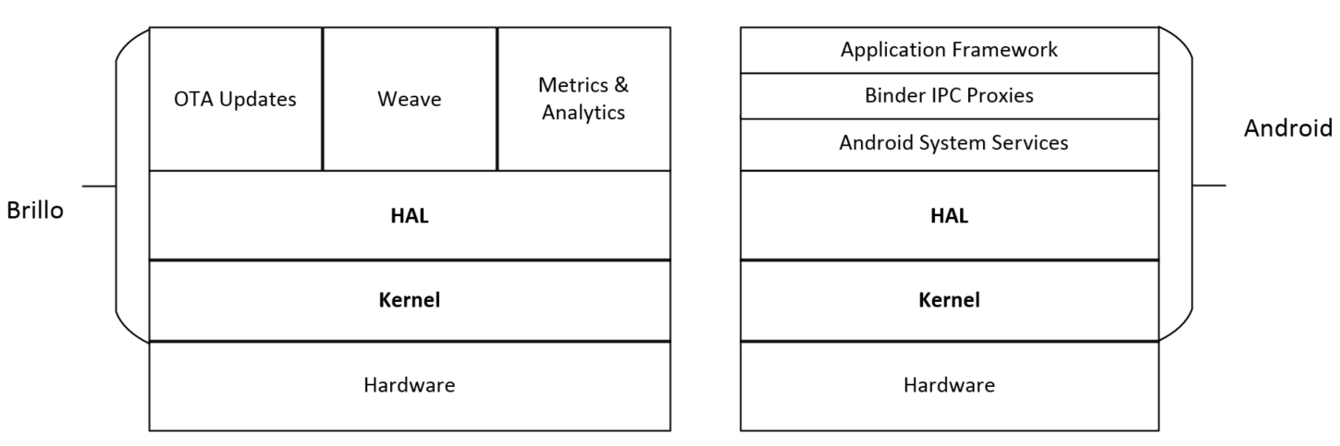
What is the scope of this course?
Notes:
If we consider the architecture of Android in the right-hand side of the following figure, we can see that most porting work will focus on the Kernel and Hardware Abstraction Layer (HAL) in the Android system architecture. This is true for other Android derivatives as well. The knowledge and concepts in this course can apply to Android wearables and Brillo as well. The left-hand side of the following figure, it shows the architecture diagram of Brillo. Brillo is the IoT operating system from Google for IoT devices. It is a simpler and smaller version of Android for IoT devices. However, the porting layer is still the same as Android.
Overview of the Android system
As we can see from the architecture diagram, the architecture layers of Android include Application Framework, Android System Services, HAL, and Kernel. Binder IPC is used as a mechanism for inter-process communication. We will cover each of them in this section. Since recovery is also part of the system programming scope, we will also give an overview of recovery in this section.
You can find more information about key porting layers and system architecture internals at the following Google website: http://source.android.com/devices/index.html

Slide 9
Kernel
As we know, Android uses the Linux kernel. Linux was developed by Linus Torvalds in 1991. The current Linux kernel is maintained by the Linux Kernel Organization Inc.
The latest mainline kernel releases can be found at https://www.kernel.org.
Android uses a slightly customized Linux kernel.
Notes:
The following is a concise list of the changes to the Linux kernel:
ashmem (Android Shared Memory): A file-based shared memory system to user space
Binder: An interprocess communication (IPC) and remote procedure call (RPC) system
logger: A high-speed in-kernel logging mechanism optimized for writes
paranoid networking: A mechanism to restrict network I/O to certain processes
pmem (physical memory): A driver for mapping large chunks of physical memory into user space
Viking Killer: A replacement OOM killer that implements Android's "kill least recently used process" logic under low-memory conditions
wakelocks: Android's unique power management solution, in which the default state of the device is sleep and explicit action is required (via a wakelock) to prevent that
Most of the changes were implemented as device drivers with little or no changes necessary to the core kernel code. The only significant subsystem-spanning change is wakelocks.
There are many Android patches accepted by the mainline Linux kernel today. The mainline kernel can even boot up Android directly. There is a blog from Linaro about how to boot Nexus 7 running a mainline kernel. If you want to try it, you can find the instructions at https://wiki.linaro.org/LMG/Kernel/FormFactorEnablement.
If a Linux device driver is available for a hardware device, it usually can work on Android as well. The development of device drivers is the same as the development of a typical Linux device driver. If you want to find out the merges on the mainline kernel related to Android, you can check the kernel release notes at https://kernelnewbies.org/LinuxVersions.
The Android kernel source code is usually provided by SoC vendors, such as Qualcomm or MTK. The kernel source code for Google devices can be found at https://android.googlesource.com/kernel/.
Google devices use SoC from various vendors so that you can find kernel source code from different vendors here. For example, the kernel source of QualComm SoC is under kernel/msm and the kernel source of Mediatek is under kernel/mediatek. The general Android kernel source code is in the folder kernel/common, which looks much like the Vanilla kernel.
The default build of AOSP is for various devices from Google, such as Nexus or Pixel. It started to include some reference boards from silicon vendors as well recently, such as hikey-linaro, and so on. If you need a vendor-specific Android kernel for your reference platform, you should get the kernel source code from your platform vendors.
There are also open source communities maintaining Android kernels. For example, the kernel for the ARM architecture can be found at Linaro for many reference boards. For Intel x86 architecture, you can find various versions of kernels in the Android-x86 project. As you can see from the following Linaro Linux Kernel status website, the linaro-android tree is a forward port of the out-of-tree AOSP patches. It provides a preview of what Google's next AOSP kernel/common.git tree "might" look like.
The Linaro Android kernel tree can be found at https://android.git.linaro.org/gitweb/kernel/linaro-android.git. The status of this kernel tree can be seen at https://wiki.linaro.org/LMG/Kernel/Upstreaming.

Slide 10
HAL
HAL defines a standard interface for hardware vendors to implement and allows Android to be agnostic about lower-level driver implementations.
HAL allows you to implement functionality without affecting or modifying the higher level system.
HAL implementations are packaged into module (.so) files and loaded by the Android system at the appropriate time.
Notes:
This is one of the focuses for porting Android systems to a new platform. We will discover more about HAL in lesson 3, Discovering Kernel, HAL, and Virtual Hardware. Throughout this course, I will give a very detailed analysis of the HAL layer for various hardware interfaces.

Slide 11
Android system services
Functionality exposed by application framework APIs communicates with system services to access the underlying hardware.
There are two groups of services that application developers may interact mostly with.
They are system (services such as window manager and notification manager) and media (services involved in playing and recording media).
Notes:
These are the services that provide application interfaces as part of the Android framework.
Besides these services, there are also native services supporting these system services, such as SurfaceFlinger, netd, logcatd, rild, and so on. Many of them are very similar to Linux daemons that you may find in a Linux distribution. In a complicated hardware module, such as graphic, both system services and native services need to access HAL in order to provide the framework API to the application layer. We will talk about system services when we debug the init process in lesson 6, Enabling Wi-Fi on the Android Emulator to lesson 9, Booting Up x86vbox Using PXE/NFS.

Slide 12
Binder IPC
The Binder IPC mechanism allows the application framework to cross process boundaries and call into the Android system services code.
This enables high-level framework APIs to interact with Android system services. An Android application usually runs in its own process space.
It doesn't have the ability to access system resources or the underlying hardware directly.
Notes:
It has to talk to system services through Binder IPC to access the system resource. Since applications and system services run in different processes, the Binder IPC provides a mechanism for this purpose.
The Binder IPC proxies are the channel by which the application framework can access system services in different process spaces. It does not mean it is a layer between the application framework and system services. Binder IPC is the inter-process communication mechanism that can be used by any process that wants to talk to another process. For example, system services can use Binder IPC to talk to each other as well.

Slide 13
Application framework
The application framework provides APIs to the applications.
It is used most often by application developers.
After an interface is invoked by the applications, application frameworks talk to the system services through the Binder IPC mechanism.
An Android application framework is not just a set of libraries for the application developers to use, It provides much more than that.
Notes:
The break-through technology that the Android application framework brought to the developer community is a very nice separation between application layers and system layers. As we know Android application development uses the Java language and Android applications run in an environment similar to the Java virtual machine. In this kind of setup, the application layer is separated from the system layer very clearly.
The Android application framework also provides a unique programming model together with a tight integration with the integrated development environment (IDE) from Google. With this programming model and related tools, Android developers can work on application development with great efficiency and productivity. All these are key reasons why Android has gained so much traction in the mobile device world.
I have given an overall introduction to all the layers in the previous Android system architecture diagram. As I mentioned about the scope of Android system programming before, we can consider all programming in Android systems as within the scope of system programming other than application programming. With this concept in mind, we actually missed one piece in the previous architecture diagram, which is recovery.

Slide 14
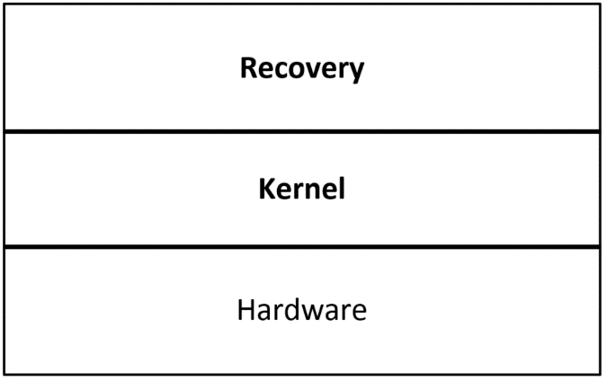
Recovery
Recovery is a tool that can be used to upgrade or reinstall Android systems.
It is part of the AOSP source code, The source code for recovery can be found at $AOSP/bootable/recovery.
The unique point about recovery compared to the other parts of Android is that it is a self-contained system by itself.
We can look at recovery using the following diagram, and compare it to the Android and Brillo architectures that we talked about before:
Notes:
In this lesson, we want to have a brief look at recovery as well, since we have three lessons about it in the second part of this course.
Recovery is a separate system from Android that shares the same kernel with the Android system that it supports. We can treat it as a mini operating system or an embedded application that we can find in many embedded devices. It is a dedicated application running on top of the same Linux kernel as Android and it performs a single task, which is to update the current Android system.

Slide 15
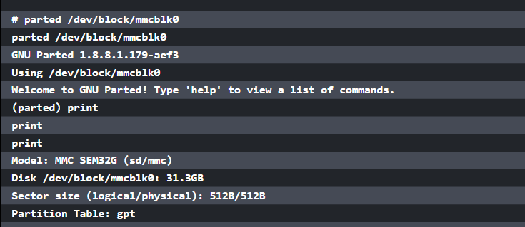
Recovery
Notes:
When the system boots to recovery mode, it boots from a dedicated partition in the flash. This partition includes the recovery image that includes a Linux kernel and a special ramdisk image. If we look at Nexus 5 partitions, we will see the following list:

Slide 16
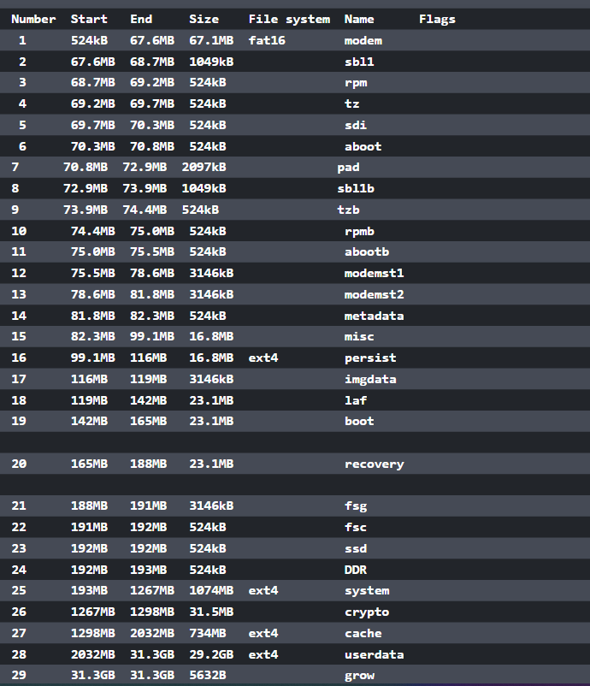
Notes:
The list includes 29 partitions and recovery partition is one of them. The recovery ramdisk of recovery, it has a similar directory structure to the normal ramdisk. In the init script of recovery ramdisk, init starts the recovery program and it is the main process of the recovery mode. The recovery itself is the same as other native daemons in the Android system. The programming for recovery is part of the scope of Android system programming. The programming language and debug method for recovery is also the same as native Android applications. We will discuss this in more depth in the second part of this course.

Slide 17
The third-party open source
projects derived from AOSP
As we know, AOSP source code is the major source that we can start to work with in system-level programming.
Various silicon vendors usually work with Google to enable their reference platforms.
This is a huge effort and they won't publish everything to the world except for their customers.
Notes:
This brings a limitation to the open source world. Since the AOSP source code is mainly for Google devices, such as emulator, Nexus, or Pixel series, there is no problem for developers who use Nexus devices as hardware reference platforms. How about other devices? Manufacturers may release the kernel source code for their devices, but nothing else. In the open source world, several third-party organizations provide solutions for this situation. We will have a brief look at the ones that we used in this course in the following sections.

Slide 18
LineageOS (CyanogenMod)
LineageOS is a community providing aftermarket firmware distribution for many popular Android devices.
It is the successor to the highly popular CyanogenMod.
If you cannot build the ROM for your devices from AOSP source code, you may look at LineageOS source code.
Because there are many devices supported by LineageOS, many major third-party ROM images are built on top of its predecessor CyanogenMod.
Notes:
From the famous MIUI in China to the latest OnePlus device, they all use CyanogenMod source code as the base start from. The major contributions of LineageOS/CyanogenMod to the open source world are the adaptation of the Linux kernel and HAL to various Android devices.
The source code of LineageOS is maintained in GitHub and you can find it at https://github.com/LineageOS.
To build LineageOS source code for your device, the overall build process is similar to the AOSP build. The key difference is the large number of devices supported by LineageOS. For each device, there is a web page to give information about how to build for a device. We use Nexus 5 as an example. You can go to the following page for detailed information:
https://wiki.lineageos.org/devices/hammerhead
In the information page, you can find information about how to download the ROM image, how to install the image, and how to build the image. There is a build guide for devices and we can find the build guide for Nexus 5 at https://wiki.lineageos.org/devices/hammerhead/build.
To build LineageOS for Nexus 5, the two key elements are Kernel and Device. The Kernel includes the Linux kernel and Nexus 5-specific device drivers, while the Device includes the major part of the device-specific HAL code. The naming convention for both the Kernel and Device folder is android_kernel/device_{manufacturer}_{code name}.
The code name for Nexus 5 is hammerhead and the manufacturer is lge, which is LG.
We can find the following two Git repositories for Kernel and Device: https://github.com/LineageOS/android_kernel_lge_hammerhead https://github.com/LineageOS/android_device_lge_hammerhead
Other than the Kernel and Device, other important information is the LineageOS version. You may find it on the same device information page. For Nexus 5, the versions that can be used are 11, 12, 12.1, 13, and 14.1. You may be wondering how to match LineageOS versions to AOSP versions.
The information can be found at the following two pages at Wikipedia about CyanogenMod and LineageOS: https://en.wikipedia.org/wiki/CyanogenMod#Version_history https://en.wikipedia.org/wiki/LineageOS#Version_history
The LineageOS/CyanogenMod and AOSP versions supported for Nexus 5 are CM11 (Android 4.4), CM 12 (Android 5.0), CM 12.1 (Android 5.1), CM 13 (Android 6.0), and CM 14.1 (Android 7.1.1).
You will not be able to access the links related to CyanogenMod while you read this course, since the infrastructure behind CyanogenMod has been shut down recently. You can read the following post to find out more: https://plus.google.com/+CyanogenMod/posts/RYBfQ9rTjEH
Nevertheless, the idea from the preceding configuration is that the key pieces of code to differentiate one device from another are the Kernel and Device. It is possible to share the rest of the code across devices. This is one of the goals for the projects in this course. We try to keep the changes for different hardware platforms within the Kernel and the Device, while keeping the rest of the AOSP source code untouched. This is not 100% possible, but we can try to do it as much as possible. The benefit is that we can keep our code separated from AOSP code and it is much easier to update to a new AOSP version.

Slide 19
Android-x86
While LineageOS/CyanogenMod provides excellent support for a large number of Android devices, many of these devices are ARM-based devices from various silicon vendors, such as Qualcomm, Samsung, MTK, and so on.
Similarly, there is an open source community for Intel-based Android devices as well, This is another famous open source project, Android-x86.
Notes:
Even though the number of Intel x86-based Android devices on the market cannot compare to the number of ARM-based devices, there is another market using the Intel x86 Android build extensively. This is the Android emulator market. For commercial Android emulator products, you can find AMI DuOS, Genymotion, Andy, and so on.
The project Android-x86 uses a very different approach to support various Intel x86-based devices compared to LineageOS/CyanogenMod. Its goal is to provide Board Support Package (BSP) for any Intel x86 devices. It is similar to how you install Microsoft Windows or Linux on your PC. You have only one copy of the release and you can install it on any Intel PCs. There is no special build of Windows or Linux for each different PC or laptop.
To achieve this goal on Android, Android-x86 customized the Android boot up process significantly. There are two stages of boot up process in Android-x86. The first stage is booting up a minimal Linux environment using a special ramdisk--initrd.img. After the system can boot up to this Linux environment, it starts the second stage through the chroot or switch_root command. In this stage, it will boot up the actual Android system.
This is a very smart way to resolve the new challenge using existing technology. Essentially, we try to resolve the problem in two steps. In the first stage of the boot up process, since both Windows and Linux can boot on Intel x86 PCs without a dedicated build, you should be able to boot Linux on an Intel device without too much effort. This is exactly what the first stage of Android-x86 boot up does. After the minimal Linux system can run properly, this means the minimum set of hardware devices is initialized and you are able to debug or boot the rest of the system using this minimal Linux environment. In the second stage, a common Android image for Intel x86 can be started with limited hardware initialization. This approach can be used in the debugging of hardware devices as well. We will show how we can do the same thing on the Android emulator in this course.
The official website of the Android-x86 project is http://www.android-x86.org/. You can find the information about the Android-x86 project there. To build Android-x86, it is a little tricky to get the source code. The original source code was hosted at http://git.android-x86.org and it was maintained by volunteers from Taiwan Linux User Group (TLUG). It was valid for several years. However, it ceased to work from April 2015.
You can always find the latest status from the Google discussion group at https://groups.google.com/forum/#!forum/android-x86. There is an official announcement about the issue of git.android-x86.org at the discussion group from the maintainer Chih-Wei Huang. Later, the hosting was moved to SourceForge for a short period. However, issues retrieving source code from SourceForge have been reported again since July 2016. Currently, the source code is hosted at OSDN and you can search the announcement from Chih-Wei Huang on September 8, 2016 at the Android-x86 discussion group. Since most open source projects are maintained by volunteers, they may be up and down from time to time. It is always good to keep your own mirror of the projects that you work on. We will discuss this issue in this course as well so that you can have full control of your own work.
We know that many open source projects are related to each other and this is true for both Android-x86 and LineageOS/CyanogenMod as well. Starting from January 2016, Jaap Jan Meijer did the initial porting of CyanogenMod to Android-x86 and this makes CyanogenMod available on most Intel devices. If you are interested in this topic, you can search for CM porting plan in the Android-x86 discussion group.

Slide 20
CWM/CMR/TWRP
The original recovery from AOSP only supports very limited functionalities so there are many third-party recovery projects.
ClockworkMod recovery (CWM) is one of the famous open source recovery projects, written by Koushik Dutta.
Even though many people still use ClockworkMod recovery now, this project ceased development some time ago.
Notes:
As a part of system-level programming, we introduced recovery in the previous section.
Another recovery project is CyanogenMod recovery (CMR). CMR is maintained by the CyanogenMod team and it is quite similar to ClockworkMod recovery.
TWRP or TeamWin Recovery Project is another very widely used custom recovery. It is fully touch-driven and has one of the most complete feature sets available. TWRP is the default recovery of OmniROM and its source code is hosted in GitHub as part of OmniROM at https://github.com/omnirom/android_bootable_recovery/.

Slide 21
Strategy of integration
In this course, we will use the AOSP source code as the foundation and try to build everything on top of it, However, we may not be able to rely on AOSP source code only.
In fact, we want to demonstrate how to support a platform that is not supported by AOSP. How are we going to do this? Do we create something from scratch? The answer is no.
Notes:
In the preceding sections, we talked about Android architecture, AOSP, and third-party open source projects for Android. The software industry has been there for decades. There are so many existing source codes that can be reused and the need to create something from scratch is very rare. The porting and customization for a new platform is basically art of integration.
We will demonstrate how we can integrate all existing projects together to create a new platform. That's the reason why we discuss third-party open source projects.
In our case, VirtualBox is not supported by AOSP and we are going to enable it using AOSP and Android-x86. We need to use projects from both AOSP and Android-x86 to build a system for VirtualBox. However, our goal is to create a new build system for VirtualBox with minimal changes to the AOSP source code tree. This is also the goal of many other projects based on AOSP.
Based on the previous understanding, we have four categories of projects in our integration process:
The original unmodified AOSP projects: In these kinds of projects, we will use AOSP projects without any changes.
The third-party projects: In this category, the projects are added by the third-party projects and are not part of AOSP, so there are no changes involved as well.
Projects modified by both AOSP and one of the third-party projects: This is complicated. We need to review the third-party changes and decide whether we want to include them in our system or not.
Projects modified by multiple open source projects and AOSP: This is the most complicated case that we should avoid to integrate or change.
It is very easy to understand that we should try to reuse projects in category 1 and 2 as much as possible. The challenges and major work will be in category 3, while we should try to avoid category 4 whenever possible.

Slide 22
Virtual hardware reference platforms
The new Android releases usually come with two reference platforms.
Developers can test the new Android releases on Android emulator first.
This can be very useful in the preview stages.
After the official release, the Google hardware platforms, such as Nexus or Pixel, usually become the devices for developers.
The emulator and Nexus/Pixel builds are the earliest builds available in AOSP.
Notes:
In this course, we will use Android emulator as the virtual hardware reference platform for our topics. Since the Android emulator build is already available in AOSP, you may wonder what we can do with it. Actually, we can customize an existing platform by adding new features to it. This is what OEM/ODM companies usually do using a reference platform from a silicon vendor. With Android emulator, we will demonstrate how to create a new device so that we can customize it. If you know any commercial emulator products, such as Genymotion and AMI DuOS, then you may know what features these products added to the emulator. We will extend Android emulator in a very similar way.
After we explore the topics about the customization of a new device, we will explore more advanced topics about porting. The major work with porting is the changes to the kernel and HAL. To discuss advanced topics about porting and debugging, we will also use VirtualBox as another virtual hardware reference platform. Even though VirtualBox has been used by many commercial emulator products, such as Genymotion, AMI DuOS, Leapdroid, and so on, it is not supported by AOSP directly. Most Android emulators for the PC are based on VirtualBox and they are designed for gamers to run Android games. In this course, we will learn how to create a similar build using various open source resources.

Slide 23
Introduction to the x86-based Android emulator
Android emulator has been changed dramatically as well in Android 4, 5, 6, and 7.
Before Android 5, Android emulator was built on a virtual hardware reference board called goldfish.
The goldfish virtual hardware platform was built on QEMU 1.x to emulate ARM devices on the x86 environment.
Notes:
The hardware specification of the goldfish virtual hardware platform can be found in the AOSP source tree at $AOSP/platform/external/qemu/docs/GOLDFISH-VIRTUAL-HARDWARE.TXT. In this course, we will refer to the AOSP root directory as $AOSP.
The x86 host environments could be a Windows, Linux, or macOS X computer. Since the target device architecture is emulated using QEMU, the performance is poor. The emulator is very slow and difficult to use for application developers. However, QEMU is actively developed on the x86 architecture and widely used together with various virtualization technologies, such as VT-x, AMD-V, and so on.
Since Android 4.x, Intel developed an x86-based Android emulator using KVM on Linux and Intel HAXM for Windows and macOS X. With the introduction of virtualization technology to the emulator, the Intel x86-based emulator is much faster than the emulated one for the ARM or MIPS architecture. For the sake of Android application developers, Google officially integrated the Intel x86-based Android emulator to Android SDK. The Intel x86-based Android emulator has become the recommended choice for developers to test their Android applications.

Slide 24
Introduction to ranchu
With the introduction of Android 5 (Lollipop), the 64-bit hardware architecture is available for both ARM and Intel platforms.
However, 64-bit hardware devices for Android were still under development at that time.
The only choice for developers was to get a hardware reference platform from silicon vendors.
Notes:
To help developers test their applications on 64-bit architecture, the engineers at Linaro did an excellent job enabling a virtual hardware platform on QEMU to test ARMv8-A 64-bit architecture. They gave this virtual hardware platform a code name, ranchu. You may refer to the blog at Linaro by Alex Bennée at https://www.linaro.org/blog/core-dump/running-64bit-android-l-qemu/.
This change was adopted by Google later and was used as the hardware reference platform for the next generation of Android emulators. If you install the Android SDK images, you can see two kernel images starting from Android 5. The kernel image kernel-qemu is the image to be used with the goldfish virtual hardware platform and the image kernel-ranchu is the image to be used with the ranchu virtual hardware platform.
To respond to this change, both Intel and MIPS worked on their architectures to support their 64-bit hardware emulation in ranchu. You can refer to the group discussions at https://groups.google.com/forum/#!topic/android-emulator-dev/dltBnUW_HzU.
The ranchu hardware platform is based on a newer QEMU version and the architecture is changed to have less dependency on Google modification and goldfish-specific devices. For example, it uses virtio-block devices to emulate the NAND and SD card. This has the potential of providing much better performance and also makes it possible to utilize the features provided by the latest QEMU code base. The ranchu kernel is built on a new version in the android-goldfish-3.10 branch, while the latest goldfish kernel is in the android-goldfish-3.4 branch. You can notice this difference by running your Android virtual device using different kernels from Android SDK.

Slide 25
VirtualBox-based Android emulators
With the ever evolving nature of virtualization technology, there are many commercial Android emulator products developed on the market as well.
You may have heard of some of them such as Genymotion, AMIDuOS, Andy, BlueStacks, and so on. Many of them are built using VirtualBox from Oracle, such as Genymotion, AMIDuOS, and Andy.
The reason that VirtualBox is used instead of other solutions such as VMware is because VirtualBox is an open source solution.
Notes:
To achieve the best performance and user experience, both host and target need to be customized in the commercial emulator products. Besides Android emulator, we will also use VirtualBox as the virtual hardware platform to demonstrate how to port Android to a new platform. The reason that we need another virtual hardware platform in this course is because Android emulator is already supported in AOSP. We will use Android emulator as a platform to teach how to extend and customize an existing platform. While VirtualBox is not supported in AOSP, it can be used as a target platform to teach how to port Android to a new platform. Even though Android has been ported to VirtualBox by Genymotion, AMI, and others, none of them are open source products.

Slide 26
Summary
In this lesson, we discussed what Android system programming is and the scope involved in system-level programming in this course.
After that, we took an overview of the Android system architecture and talked about the layers that we will focus on in this course.
We also discussed the virtual hardware platforms that we use in this course.
Notes:
In this course, we use the code from various third-party projects, so we also took a brief overview of each of them in this lesson. In the next lesson, we will start to learn about the development environment setup for Android system programming. This includes both development tools and the source code repository setup.

Slide 27

"Complete Lab"

Slide 28
Setting Up the Development Environment

Slide 29
Setting Up the Development Environment
We will cover the following topics in this lesson:
Installing the Android SDK and setting up an Android Virtual Device
Setting up the AOSP build environment and building a testing image
Creating your own source code repository mirror
Notes:
After the introduction about system programming in the last lesson, we need to set up a development environment first before we can go further. We need to know how to build and test Android Open Source Project (AOSP) while we explore various Android system programming topics in this course.

Slide 30
Summary of Android versions
Since we will use Android emulator as one of the virtual hardware platforms, we need to use one particular Android version throughout this course.
At the time of writing, the latest Android version is Android 7 (Nougat).
We will use Android 7 throughout the course, I started work on this course with Android 6, so the source code for Android 6 is also available in my GitHub repository at https://github.com/shugaoye.
Notes:
From the first release to Android 7, both the development environment and the AOSP source code have been changed a lot. We will have a brief look at various Android versions first before we talk about the development environment setup.
To set up the AOSP build environment, there are two things that you need to pay special attention to the host environment and Java SDK. Even though the recommended host environment is Ubuntu running on Intel architecture, the hardware architecture and Ubuntu versions have changed from release to release. You can always refer to the following URL at Google for the latest AOSP build environment setup:
https://source.android.com/source/index.html
For Gingerbread (2.3.x) and above, a 64-bit build environment is required. For older versions, the build environment is 32-bit systems.
The Ubuntu versions used range from Ubuntu 10.04 to 14.04, but for each release there is a recommended Ubuntu version. If it is a new setup, it is suggested to use the recommended Ubuntu version to make the job easier. However, there are no hard requirements here. You should be able to use any Ubuntu version higher than the recommended Ubuntu version. There are also many articles about how to set up the AOSP build using a different Linux distribution such as RedHat or Debain.
Oracle JDK was used to build AOSP until Lollipop. From Lollipop and the above, OpenJDK was used instead of Oracle JDK.

Slide 31
Installing Android SDK and setting up an Android Virtual Device
Ideally, if you have an AOSP build environment, you can build everything including Android SDK from scratch.
However, it is much more convenient to have an Android SDK installation to help with virtual device creation or running emulator images.
You can always download the latest Android SDK from the following website:
https://developer.android.com/index.html
Notes:
The host environment that we use in this course is Ubuntu 14.04. Download the Android SDK for Linux and decompress it to a folder in your Home directory.
The tools in Android SDK have been changed since API level 25. You may use an older version of Android SDK or the latest Android SDK so I gave the instructions for both cases here.

Slide 32
Creating AVD in an older version of SDK
For the older version of SDK, such as android-sdk_r24.4.1-linux.tgz, it includes all necessary components and we can use it after decompression.
We can find the following contents after decompressing:
$ ls android-sdk-linux
add-ons platforms SDK Readme.txt temp
build-tools platform-tools system-images tools
Notes:
You can add the platform-tools and tools directory to your PATH environment variable.
We will use a virtual device based on API level 25 in this course to test our image.

Slide 33
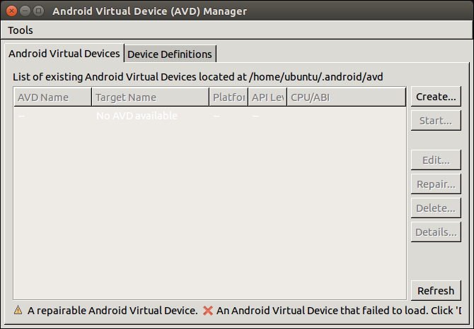
Creating AVD in an older version of SDK
To create a virtual device, we can launch Android Virtual Device (AVD) Manager using the following command, as shown in the following screenshot:
$ android avd

Slide 34
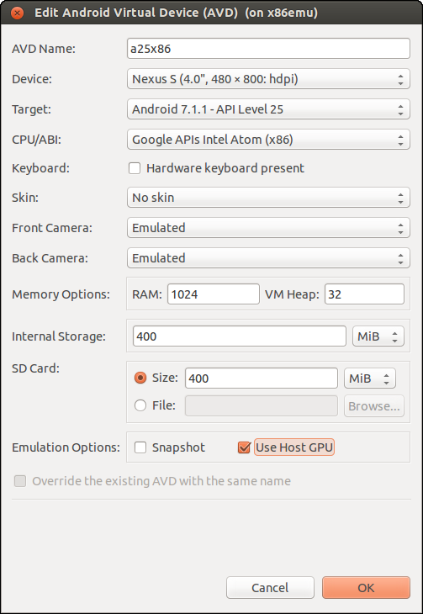
Creating AVD in an older version of SDK
Notes:
Click the Create... button in AVD Manager and create a new virtual device named a25x86 with the following configuration, as shown in the following screenshot:
Android 7.1.1 - API level 25
1024 MB RAM
400 MB SD card
400 MB internal storage
Display size at 480 x 800: hdpi

Slide 35
Creating AVD in the latest version of SDK
For the newer versions, there is only SDK command-line tools available for download.
For example, if you download the command-line tools for r25, such as tools_r25.2.3-linux.zip, you can find the tools folder only.
In this case, you need to use Android SDK Manager at tools/bin/sdkmanager to download the rest of SDK components.
To download the rest of SDK components, you can use the following command:
$ sdkmanager --update

Slide 36
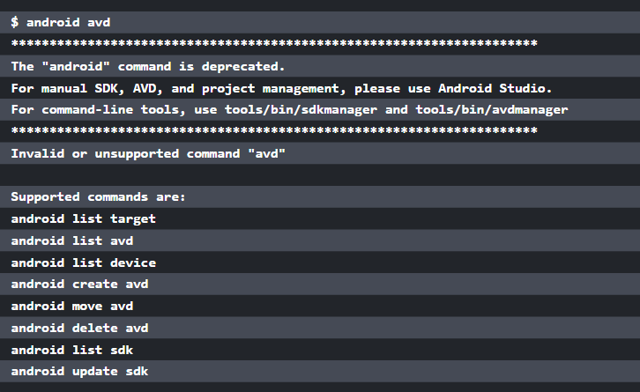
Creating AVD in an older version of SDK
Notes:
If you use the latest version of Android SDK, you may get the following error message, if you follow the previous instructions:

Slide 37
Creating AVD in an older version of SDK
In this case, you can create AVD using the following command.
$ avdmanager create avd -n a25x86 --tag google_apis -k 'system-images;android-25;google_apis;x86'
Auto-selecting single ABI x86
Do you wish to create a custom hardware profile? [no]

Slide 38
Testing the goldfish emulator
$ emulator @a25x86 -verbose -show-kernel -shell -engine classic
emulator:Found AVD name 'a25x86'
emulator:Found AVD target architecture: x86
emulator:Looking for emulator-x86 to emulate 'x86' CPU
...
kernel.path = /home/roger/android-sdk-linux/system-images/android-
25/default/x86/kernel-qemu
...
Notes:
In Android 7, both the ranchu and goldfish emulators are supported. Let's test the goldfish emulator first. We can run this virtual device in the goldfish emulator using the following command:
To monitor the status of a virtual device, we can use the following Android emulator options:
-verbose: Shows the emulator debug information.
-show-kernel: Shows kernel debug information.
-shell: Uses stdio as the command line prompt.
-engine: Selects the emulator engine. The choice can be auto, classic, or qemu2. The classic option is to use the goldfish emulator and the qemu2 option is to use the ranchu emulator. If the option is auto or without the engine option, the system will check the environment and try to launch ranchu first. If it fails, it will fall back to goldfish.
From the preceding log, we can see that the kernel-qemu kernel file is used for the goldfish emulator.

Slide 39
Testing the goldfish emulator
Both the ranchu and goldfish emulators are developed on top of QEMU, but they use different kernel and QEMU versions.
We can verify the QEMU version used for either goldfish or ranchu using the following emulator commands.
To verify the QEMU version used by goldfish, we can run the following command:
$ emulator -engine classic -qemu -version
QEMU PC emulator version 0.10.50 Android, Copyright (c) 2003-2008 Fabrice Bellard
Notes:
From the preceding output, we can see that QEMU version 0.10.50 is used for the goldfish emulator.

Slide 40
Testing the goldfish emulator
For the latest emulator version, it seems there is a bug with regard to handling the classic engine.
You may get the following error message, when you execute the preceding command:
$ emulator -engine classic -qemu -version
emulator: ERROR: android_qemud_get_serial_line: can't create charpipe to serial port
Notes:
The emulator command is a wrapper for QEMU. Any command-line options after -qemu are passed to QEMU as the command lines of QEMU directly. To find out the emulator version, we can use the following command: $ emulator -version The following command will show the QEMU version: $ emulator -qemu -version

Slide 41
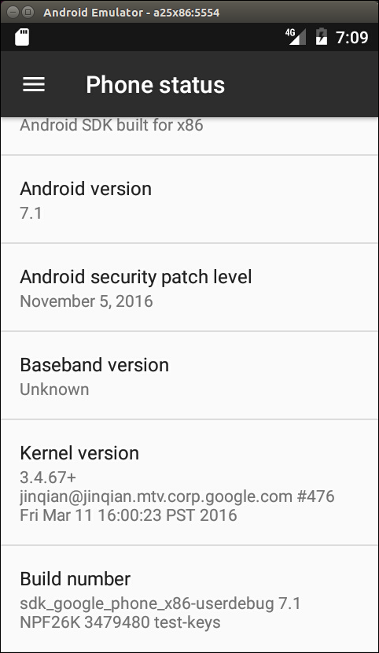
Testing the goldfish emulator
After the Android device has started successfully, from the Android UI, we can go to Settings -> About Phone and see the screen shown in the following screenshot:
Notes:
Pay attention to the following information on the About Phone screen:
Android version: 7.1
Kernel version: 3.4.67
Build number: sdk_google_phone_x86-userdebug 7.1 NPF26K 3479480 test-keys
As we can see from the preceding information, the kernel version is 3.4.67 and the filesystem build number is sdk_google_phone_x86-userdebug 7.1 NPF26K 3479480 test-keys for goldfish emulator. In the next section, we can see that ranchu emulator uses a different kernel version, even though both emulators share the same filesystem.
The Android system build includes two parts: the AOSP system and an Android-compatible Linux kernel. The build result of the AOSP system includes all image files for the Android system except the kernel image. They are built separately and are also under difference licenses. The preferred license for the AOSP is the Apache Software License, while the Linux kernel is under the GPLv2 License. Be aware of this difference. It also means that the AOSP build doesn't include the kernel build. We have to build the kernel separately. We can also use different kernel images with the same filesystem as in the test of the goldfish and ranchu emulator.
When we talk about the Android version, we have to look into the details of the kernel version and filesystem build number.

Slide 42
Testing ranchu emulator
$ emulator @a25x86 -verbose -show-kernel -shell
emulator:Found AVD name 'a25x86'
emulator:Found AVD target architecture: x86
emulator: Found directory: /home/roger/android-sdk-linux/system-images/android-25/default/x86/
emulator:Probing for /home/roger/android-sdk-linux/system-images/android-25/default/x86//kernel-ranchu: file exists
emulator:Auto-config: -engine qemu2 (based on configuration)
emulator:Found target-specific 64-bit emulator binary: /home/roger/android-sdk-linux/tools/qemu/linux-x86_64/qemu-system-i386
...
Notes:
We can test ranchu emulator as well with the same virtual device. We can use a similar command without the -engine option or with the -engine qemu2 option to start ranchu emulator:

Slide 43
Testing ranchu emulator
From the preceding log, we can see that the kernel file kernel-ranchu is used in ranchu emulator.
We can also verify the QEMU version used by ranchu emulator using the following command:
$ emulator -qemu -version
QEMU emulator version 2.2.0 , Copyright (c) 2003-2008 Fabrice Bellard
Notes:
We can see that ranchu uses a much newer QEMU version that can support many new features, which we will discuss later in this course.

Slide 44
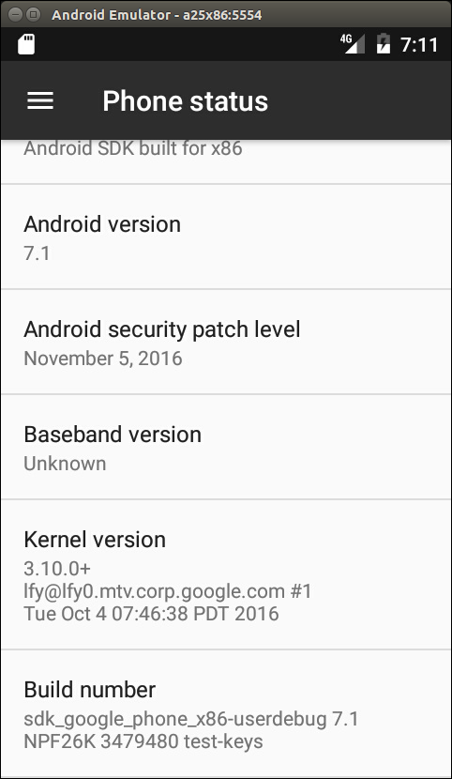
Testing ranchu emulator
Again, let's review the version information in Settings as we did for goldfish emulator; refer to the following screenshot:
Notes:
We can see that the ranchu emulator uses the kernel version 3.10.0, which is different from the goldfish emulator. The filesystem build is the same as for the goldfish emulator.

Slide 45
The AOSP build environment and the Android emulator build
In order to create our own Android system, we have to set up the AOSP build environment and build our own AOSP target for the Android emulator.
Since Android is under rapid development, the build process and environment setup can change from time to time.
You can always refer to Google's website for the latest information, https://source.android.com/source/building.html.
Notes:
While the Google website and other sources can give general guidelines and procedures about the AOSP build, in this section we will look specifically at how to build AOSP for Android emulator image for API level 25.
The AOSP build environment
Since we want to set up a build environment for API level 25, you can refer to the table of AOSP releases for the basic requirements about the host and JDK. It is recommended to use the Ubuntu 14.04 64-bit host with Open JDK 8. For the hardware requirement, you may want to have a powerful enough computer with at least 8 GB RAM and 500 GB hard disk space.

Slide 46
Installing the required packages
If you use a different Linux distribution, you can refer to Google's website or search on the Internet for the relevant setup procedures.
Let's execute the following commands to install all necessary packages for Ubuntu 14.04:
$ sudo apt-get install git-core gnupg flex bison gperf build-essential\
zip curl zlib1g-dev gcc-multilib g++-multilib libc6-dev-i386\
lib32ncurses5-dev x11proto-core-dev libx11-dev lib32z-dev ccache\
libgl1-mesa-dev libxml2-utils xsltproc unzip
Notes:
We use the Ubuntu 14.04 64-bit version as our host operating system. After installing Ubuntu 14.04, the first thing you have to do is to install all necessary software packages as follows.

Slide 47
Installing Open JDK 7 and 8
We will install both Open JDK 7 and 8 so we can build both Android 6 and 7 in our build environment.
To build Android API level 23, we need to install OpenJDK 7.
We can execute the following commands from the Linux console to install OpenJDK 7:
$ sudo apt-get update
$ sudo apt-get install openjdk-7-jdk
Notes:
For Android 7, we need to use OpenJDK 8 to build. There are no available supported OpenJDK 8 packages for Ubuntu 14.04 yet, but the Ubuntu 15.04 OpenJDK 8 packages have been used successfully with Ubuntu 14.04. We need to install OpenJDK 8 on Ubuntu 14.04 using the following instructions.

Slide 48
Installing Open JDK 7 and 8
Download the .deb packages for 64-bit architecture from archive.ubuntu.com:
openjdk-8-jre-headless_8u45-b14-1_amd64.deb with SHA256 0f5aba8db39088283b51e00054813063173a4d8809f70033976f83e214ab56c0
openjdk-8-jre_8u45-b14-1_amd64.deb with SHA256 9ef76c4562d39432b69baf6c18f199707c5c56a5b4566847df908b7d74e15849
openjdk-8-jdk_8u45-b14-1_amd64.deb with SHA256 6e47215cf6205aa829e6a0a64985075bd29d1f428a4006a80c9db371c2fc3c4c
Notes:
Optionally, confirm the checksums of the downloaded files against the SHA256 string listed with each preceding package.

Slide 49
Installing Open JDK 7 and 8
For example, with the sha256sum tool:
$ sha256sum {downloaded.deb file}
Install the packages:
$ sudo apt-get update
Run dpkg for each of the .deb files you downloaded, It may produce errors due to missing dependencies:
$ sudo dpkg -i {downloaded.deb file}

Slide 50
Installing Open JDK 7 and 8
To fix missing dependencies:
$ sudo apt-get -f install
With both OpenJDK 7 and 8 installed, we can update the default Java version by running the following commands:
$ sudo update-alternatives --config java
$ sudo update-alternatives --config javac
Notes:
We have a build environment ready now. You may want to refer to Google's website to set up other things. For example, we may want to use cache to speed up the build or set up a separate output directory out of the AOSP tree.

Slide 51
Downloading the AOSP source
Once we have a build environment ready, we need to get the AOSP source code.
Again, refer to Google's website or the Internet to get more information.
You need to download the Android 7 source code from source.android.com.

Slide 52
Installing repo
AOSP consists of a large number of Git repositories, and we have to use the repo tool to manage these Git repositories.
To download and install repo, we can use the following commands:
$ mkdir ~/bin
$ PATH=~/bin:$PATH
$ curl https://storage.googleapis.com/git-repo-downloads/repo > ~/bin/repo
$ chmod a+x ~/bin/repo

Slide 53
Initializing a repo client and downloading the AOSP source tree
After we have the repo tool, we can initialize the repo and download the AOSP source tree by executing the following commands:
$ repo init -u https://android.googlesource.com/platform/manifest -b android-7.1.1_r4
$ repo sync
Notes:
Pay attention to the AOSP tag android-7.1.1_r4 here. This is the version of AOSP source code that we use throughout this course.

Slide 54
Initializing a repo client and downloading the AOSP source tree
It will take quite a long time to get the AOSP source tree. After we get the source tree, let's take a look at the top level folders:
$ ls -F
abi/ cts/ docs/ libcore/ packages/ tools/
art/ dalvik/ external/ libnativehelper/ pdk/
bionic developers filelist Makefile prebuilts
bootable development frameworks ndk sdk
build device hardware out system
Notes:
Pay attention to the AOSP tag android-7.1.1_r4 here. This is the version of AOSP source code that we use throughout this course.

Slide 55
Creating your own repository mirror
It usually takes a very long time to download the AOSP source code.
After you have downloaded the AOSP source code, you have actually downloaded a specific version of the AOSP source code from the remote repository.
You may have to test different configurations or versions in your development work. It is a very time-consuming task to switch to a different version or create a new copy of the AOSP source code.
Notes:
In this course, we will use the AOSP source code as the base for our development. To reuse some of the existing open source projects that are not included in AOSP, we have to modify the repo manifest from time to time. This involves changing the repo configuration. To work more efficiently, we can use a local mirror. It can save a lot of time to create a local mirror instead of downloading source code from remote repositories for all configuration changes. It may take hours to change a configuration from a remote repository, but it will need just a few minutes with the local repository.
When we work with open source projects, the server to host the project may change from time to time. It is always good to have your own mirror so that we won't rely too much on the remote repositories. With a local mirror, we can still work without too much impact even though the remote server may be not available for a certain period. This is exactly the issue that I face when I try to integrate Android-x86 projects in the later part of this course.
I will explain how to create a mixed local mirror of AOSP, Android-x86, and GitHub in this section.

Slide 56
Repo and manifest
After we run the repo init command as we did in the previous section, a .repo folder is created under the current folder.
If we take a look at the .repo folder, we can see the following contents:
$ ls -F .repo
manifests/ manifests.git/ manifest.xml@ repo/
Notes:
To create and manage repository mirrors, we need to understand the repo command and the directory structure managed by repo a little more. The repo command deals with a XML file manifest and it stores everything in a folder called .repo.
Three folders and a symbolic link are created. The following is an explanation of each:
manifests: This is a working copy of the Git repository of the manifest itself.
manifests.git: This is the Git repository of the manifest. The manifest itself is under the version control using Git.
manifest.xml: This is a symbolic link to the file .repo/manifests/default.xml. This file is the main configuration file used by repo. We will look into the details later.
repo: The repo tool itself is written in the Python language. Python scripts are stored in this folder.

Slide 57
Repo and manifest
After we run the repo init command to initialize the repo data structure, we can run the repo sync command to retrieve a working copy.
If we look at the .repo folder again after the repo sync command, we can see that there are two project related folders created:
$ ls -F .repo
manifests/ manifest.xml@ project-objects/ repo/
manifests.git/ project.list projects/
Notes:
The following is an explanation of the newly created file and folders:
project.list: This is a list of all projects downloaded.
project-objects: This is a copy of the remote repository.
projects: This is the repository hierarchy matching the working copy. The path may be rearranged after a repository is copied to local. The contents in this folder are symbolic links to the items in project-objects.

Slide 58
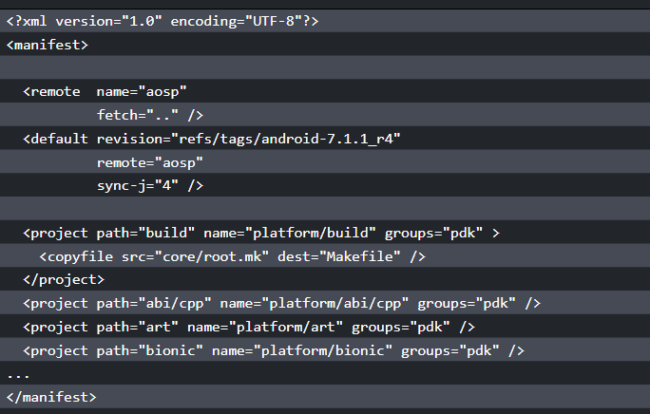
Repo and manifest
Notes:
The most important file in the .repo folder is .repo/manifests/default.xml or its symbolic link manifest.xml. The detailed specification of this file can be found in the document under the .repo folder at .repo/repo/docs/manifest-format.txt. We won't go into any details, but let's take look at the most commonly used elements.
In the preceding code snippet, we can see that there are three XML elements inside manifest:
remote: The remote element provides the details about remote repository. We can give it a name such as aosp. The URL of the remote repository can be specified in the fetch field. It can be a relative path or a full path.
default: There are multiple remote elements that can be specified in manifest. The default element defines which remote is the default one.
project: Each project element defines a Git repository. The path field supplies the local path after it is downloaded. The name field supplies the remote path of the Git repository. The revision field supplies the branch that we want to get and the remote field tells us which remote server we use to get the Git repository.
There are other XML elements that can be used in manifest as well. You can find out what they are by looking at the preceding specification yourself.

Slide 59
Using a local mirror for AOSP
If you refer to the article from the Google website about downloading the source, you can find a section called Using a local mirror.
It reveals that if you need two different configurations of the AOSP build environment, the download for two clients is larger than the size of a full mirror of the repository.
It is very simple to set up a mirror as follows:
$ mkdir -p /usr/local/mirror/aosp
$ cd /usr/local/mirror/aosp
$ repo init -u https://android.googlesource.com/mirror/manifest --mirror
$ repo sync

Slide 60
Using a local mirror for AOSP
After we run the repo init command to initialize the repo data structure, we can run the repo sync command to retrieve a working copy.
If we look at the .repo folder again after the repo sync command, we can see that there are two project related folders created:
$ ls -F .repo
manifests/ manifest.xml@ project-objects/ repo/
manifests.git/ project.list projects/

Slide 61
Using a local mirror for AOSP
<?xml version="1.0" encoding="UTF-8"?>
<manifest>
<remote name="aosp"
fetch=".." />
<default revision="master"
remote="aosp"
sync-j="4" />
<project name="accessories/manifest" />
<project name="brillo/manifest" />
...
</manifest>
Notes:
From the preceding commands, we can see that we actually use a different manifest to create a mirror. If we look at the content of the manifest for a mirror, we can see the following XML code:
We can see that for all projects, there are only the project names without other information in each project item. This is because we actually copy each Git repository to the local as a bare Git repository. We won't check out a working copy, so we don't need to worry about the version.

Slide 62
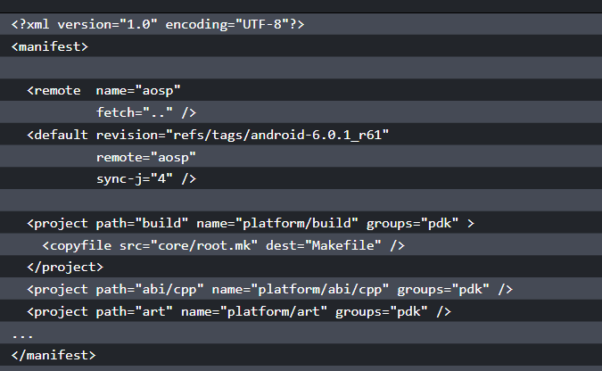
Using a local mirror for AOSP
Notes:
If we look at the manifest to check out a working copy, we will see the following:
It includes more items than the one to create a mirror. The name field specifies the path at the remote repository and the path field specifies the local path after the repository is downloaded to the local. We also need to specify revision that we want to retrieve.

Slide 63
Using a local mirror for AOSP
After we have a mirror, we can check out a copy of the AOSP source from that mirror as follows:
$ mkdir -p $HOME/aosp/master
$ cd $HOME/aosp/master
$ repo init -u /usr/local/mirror/aosp/platform/manifest.git
$ repo sync
Notes:
If you need, you can check out multiple copies from the local mirror. No matter if you check out multiple copies or you change to a different version, you can save a lot of time compared to checking out from a remote repository.
When you work on a system-level project, you may need projects out of the AOSP source. For example, in this course, we use multiple projects from CyanogenMod, Android-x86, and my own projects in GitHub. In this case, we can actually create our own manifest to mix all projects that we need together from our local mirror. Our local mirror will become a superset of the public mirror. We can create branches and tags from time to time in local repositories, but we only push the baselines that we want to release to the public repositories. This is exactly what the Google development team does in their private repositories.

Slide 64
Summary
In this lesson, we set up the environment for SDK and AOSP. We built the Android emulator images for AOSP. We also tested and compared the Android images in Android SDK and AOSP.
All these steps are necessary before we continue exploring how to create our own Android system later.
Notes:
We also spent some time discussing how to set up our own repo mirror. This tip can help us later, when we start to create projects from multiple open source projects. In the next lesson, we will start to explore the architecture of Android. We will look into the details of layers related to the porting and customization of the Android system.

Slide 65
Discovering Kernel, HAL, and Virtual Hardware

Slide 66
Discovering Kernel, HAL, and Virtual Hardware
In this lesson, we will cover the following topics:
Deep analysis of Android HAL using the goldfish lights service
Review the hardware specification for goldfish
Overview about QEMU pipe implementation in the goldfish kernel
Notes:
Once we set up the development environment and get the source code ready to use. We can start to explore the Android system architecture in more depth. We will look at the AOSP source tree first. After that, we will study the virtual hardware platforms that we are going to use in this course. Based on our understanding of the virtual hardware, we will look at the layers related to the system customization.

Slide 67
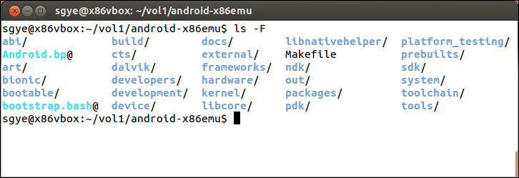
What is inside the AOSP?
Before we move to the details, let's take a look at the top level of the AOSP source code tree again:

Slide 68
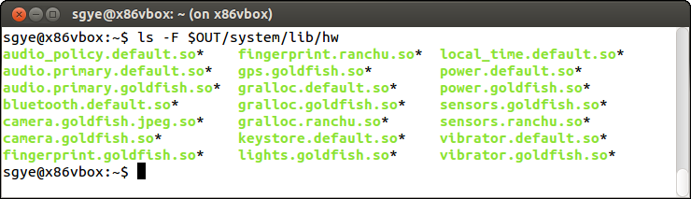
Android emulator HAL
We built the Android emulator in lesson 2, Setting Up the Development Environment.
In order to have an overview of Android emulator HAL, we can take a look at the $OUT/system/lib/hw folder as follows:
Notes:
Usually, the HAL implementation is a shared library and it will be loaded by system service at runtime. It actually depends on the complexity of the hardware itself when it comes to deciding the actual implementation. For example, there is no separate shared library for simple hardware such as serial ports. The system service implementation of a serial port accesses the device node directly.
For more complicated hardware devices, such as graphics, there is a dedicated daemon SurfaceFlinger running in the background as well as multiple shared libraries associated with it.
In this lesson, we will analyze the HAL of device goldfish lights and use it as an example to understand the relationship between frameworks, system servers, and HAL implementation. After that, we will go through the hardware interface for goldfish devices. Finally, we will analyze the QEMU pipe implementation in the goldfish kernel.

Slide 69
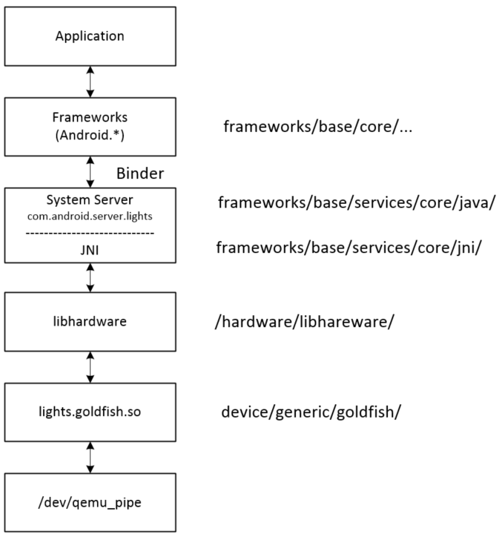
Calling sequence
We will use the lights hardware interface as an example to explain how HAL, system services, and hardware managers work together.

Slide 70
Calling sequence
When an application wants to access hardware resources, it has to get an instance of the hardware manager first.
For goldfish lights, the code in the application may look as follows:
LightsManager lights =
LocalServices.getService(LightsManager.class);
mBacklight = lights.getLight(LightsManager.LIGHT_ID_BACKLIGHT);
mBacklight.setBrightness(brightness);
Notes:
The hardware manager talks to the system service to get hardware access. Usually, the hardware manager is implemented in Java. It calls to the system service using a binder interface since the hardware manager and system service run in different process spaces. The upper layer of the system service also implements in Java. After the system service gets the request, it will call to HAL library using JNI since the HAL is implemented using C or C++ usually.

Slide 71
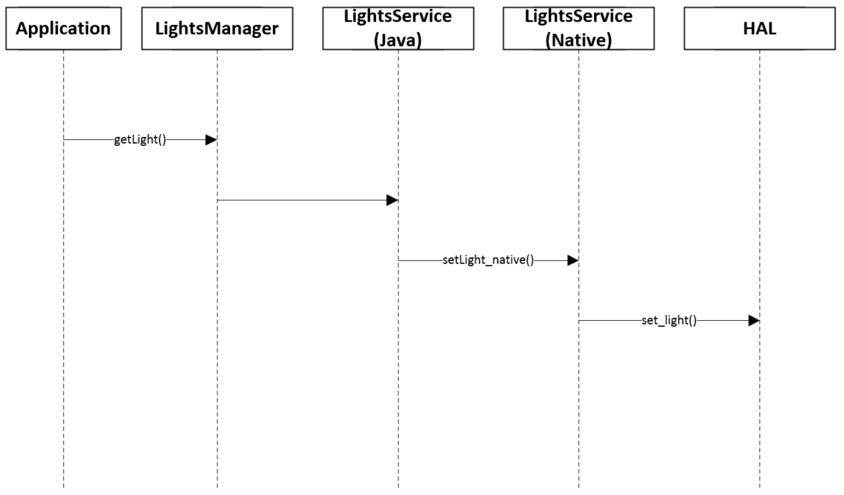
Calling sequence
Notes:
The preceding figure shows the calling sequence when an application wants to change the light on the device. We will use a bottom-up approach in this section to look at the calling sequence from HAL to the application layer.

Slide 72
Goldfish lights HAL
The goldfish lights HAL implementation can be found in the $AOSP/device/generic/goldfish/lights folder.
To implement the HAL layer, the hardware vendor usually needs to implement the following three data structures:
struct hw_module_t;
struct hw_module_methods_t;
struct hw_device_t;

Slide 73
Goldfish lights HAL
/*
* The emulator lights Module
*/
struct hw_module_t HAL_MODULE_INFO_SYM = {
.tag = HARDWARE_MODULE_TAG,
.version_major = 1,
.version_minor = 0,
.id = LIGHTS_HARDWARE_MODULE_ID,
.name = "Goldfish lights Module",
.author = "The Android Open Source Project",
.methods = &lights_module_methods,
};
Notes:
All the preceding three data structures are implemented in the lights_qemu.c file for goldfish. In the HAL implementation, we need to define struct hw_module_t named HAL_MODULE_INFO_SYM first as follows. This registers the hardware module ID LIGHTS_HARDWARE_MODULE_ID in the system. After this, lights system service can get the module using the hw_get_module function:

Slide 74
Goldfish lights HAL
You may notice that the method field has a pointer of lights_module_methods inside the preceding data structure.
It is defined as follows:
static struct hw_module_methods_t lights_module_methods = {
.open = open_lights,
};
Notes:
This defines the second HAL data structure hw_module_methods_t. Inside this data structure, it defines an open_lights method, which is the HAL function to initialize the hardware.

Slide 75
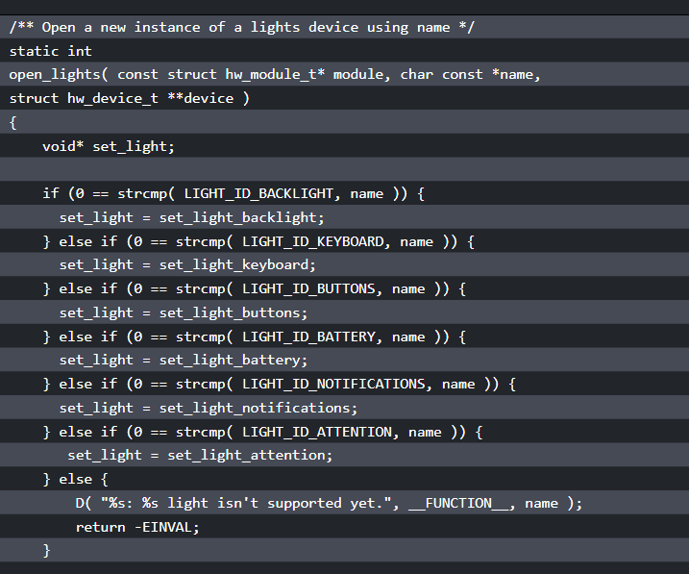
Goldfish lights HAL
Notes:
Let's take a look at this function as follows:

Slide 76
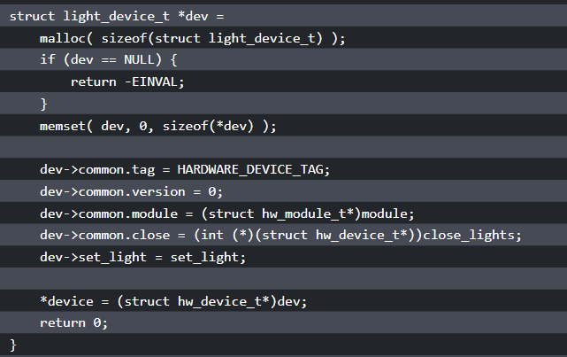
Goldfish lights HAL
Notes:
Inside open_lights, it allocates the memory for the light_device_t data structure, which inherits the third HAL data structure, hw_device_t. When it initializing the data structure light_device_t, it registers two functions, close_lights and set_light, so the system service can call these functions to change the light or close the device. The function pointer set_light is set to a specific function according to the type of light.

Slide 77
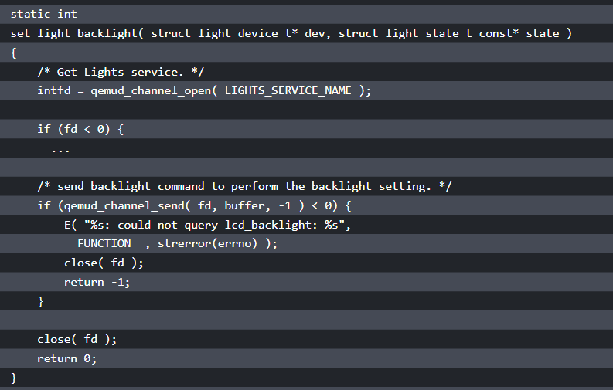
Notes:
Inside each set_light_xxx function, it talks to the kernel space through the QEMU pipe device /dev/qemu_pipe. For example, we can take a look at set_light_backlight:
Inside the set_light_backlight function, it calls qemud_channel_open and qemud_channel_send to do the actual work. Both functions use the QEMU pipe device /dev/qemu_pipe eventually.

Slide 78
The system service and hardware manager
To analyze how the application accesses light hardware, refer to the figure of the lights service calling sequence.
In an application, what calls the getService(LightsManager.class) function to get an instance of LightsManager as follows:
LightsManager lights =
LocalServices.getService(LightsManager.class);
mBacklight = lights.getLight(LightsManager.LIGHT_ID_BACKLIGHT);
Notes:
Usually the hardware manager and system service are implemented in different processes for most hardware interfaces. However, the hardware of the light is so simple, so both the system service and hardware manager are implemented in the same process.
The system service includes two parts: Java and JNI. The JNI implementation can be found at frameworks/base/services/core/jni, while the Java implementation can be found at frameworks/base/services/core/java/com/android/server. Both LightsManager and LightsService are implemented in frameworks/base/services/core/java/com/android/server/lights.

Slide 79
The system service and hardware manager
There are three files in this folder as follows.
They implement both LightsManager and LightsService:
$ ls
Light.java LightsManager.java LightsService.java
Notes:
Usually the hardware manager and system service are implemented in different processes for most hardware interfaces. However, the hardware of the light is so simple, so both the system service and hardware manager are implemented in the same process.
The system service includes two parts: Java and JNI. The JNI implementation can be found at frameworks/base/services/core/jni, while the Java implementation can be found at frameworks/base/services/core/java/com/android/server. Both LightsManager and LightsService are implemented in frameworks/base/services/core/java/com/android/server/lights.

Slide 80
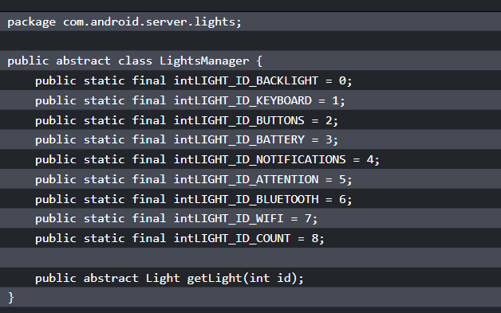
The system service and hardware manager
Notes:
Let's look at LightsManager first. We can see from the following snippet that LightsManager only returns an abstract class, Light, to the caller:

Slide 81
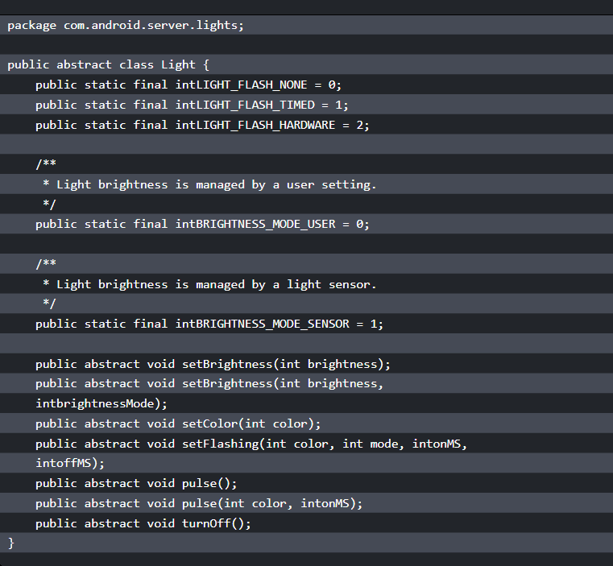
Notes:
Let's follow the code to look at the abstract class Light. In the abstract class Light, it defines a list of functions that have to be implemented for Light. These functions are implemented in the LightsService class:

Slide 82
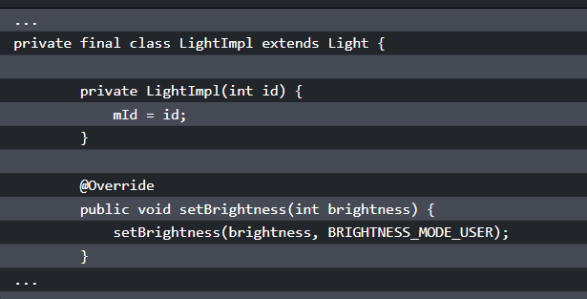
The system service and hardware manager
Notes:
In LightsService.java in the following snippet, it implements the list of functions defined by the Light class:
This set of functions in the abstract class Light calls a setLightLocked function to do the actual work.

Slide 83
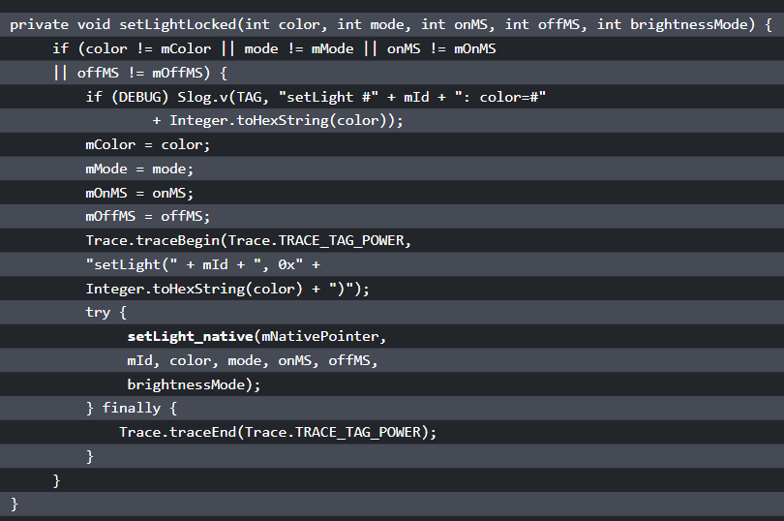
Notes:
In this function, it calls a native function, setLight_native, to invoke the native part of LightsService:

Slide 84
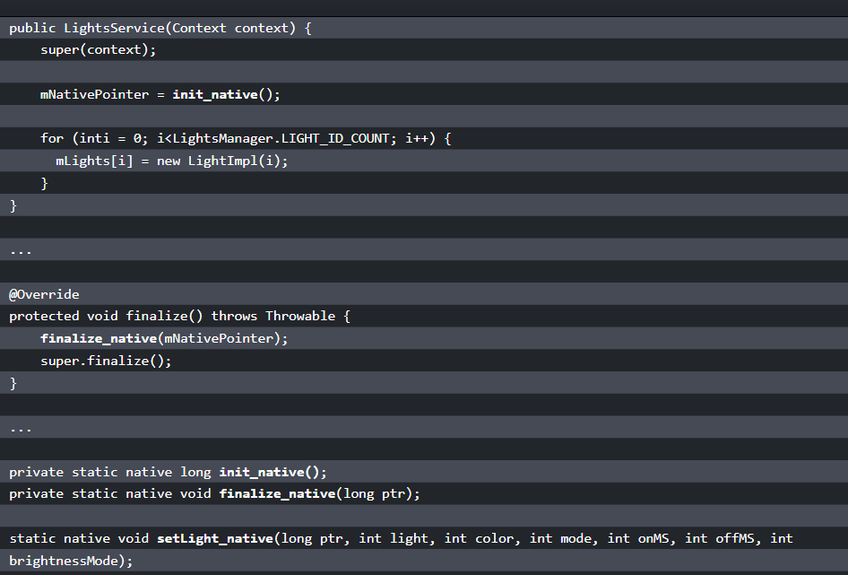
Notes:
Besides setLight_native, LightService also calls two more native functions, init_native and finalize_native. We can see this in the following code snippet. These two functions call to the HAL layer functions, as we discussed in the previous section:

Slide 85
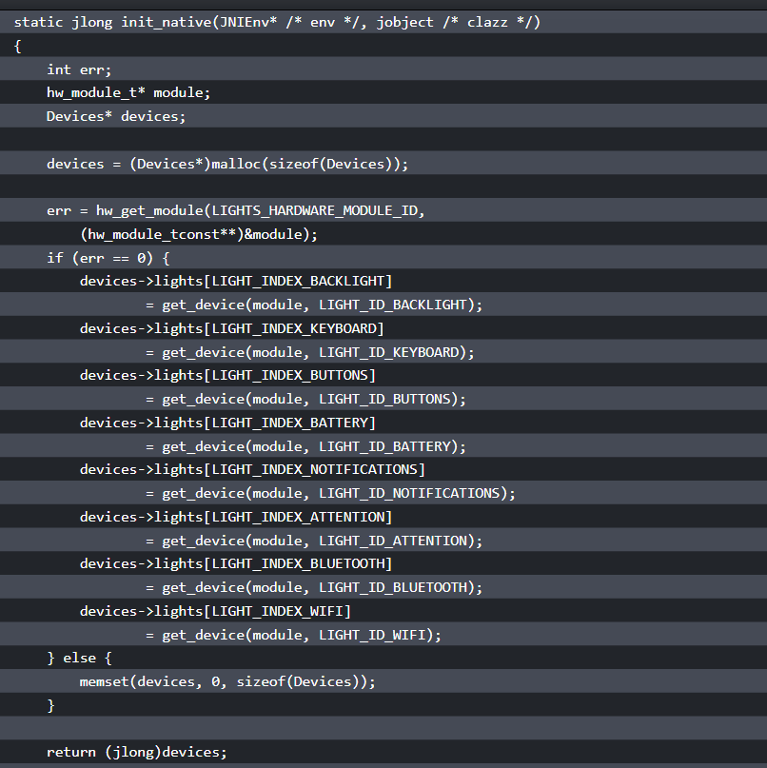
Notes:
We have looked at the implementation of LightsManager and the Java implementation of LightsService. Now let's explore the JNI part of the LightsService implementation. The JNI part is implemented in com_android_server_lights_LightsService.cpp, which can be found in the $AOSP/frameworks/base/services/core/jni folder. We will look at how these three native functions used in LightsService are connected to the HAL layer:

Slide 86
The system service and hardware manager
static light_device_t* get_device(hw_module_t* module, char const* name)
{
int err;
hw_device_t* device;
err = module->methods->open(module, name, &device);
if (err == 0) {
return (light_device_t*)device;
} else {
return NULL;
}
}
Notes:
In the init_native function, it calls the hw_get_module function to get the light HAL module using LIGHTS_HARDWARE_MODULE_ID as the hardware ID. If you look back, it is defined in the HAL. This function loads the shared library of HAL implementations. In this case, it loads lights.goldfish.so. After loading the shared library, it calls get_device to initialize all the light devices. We can see the implementation of get_device in the following snippet:
In get_device, it invokes the open method and gets the instance of HAL data structure hw_device_t. We discussed the open method in the goldfish lights HAL.

Slide 87
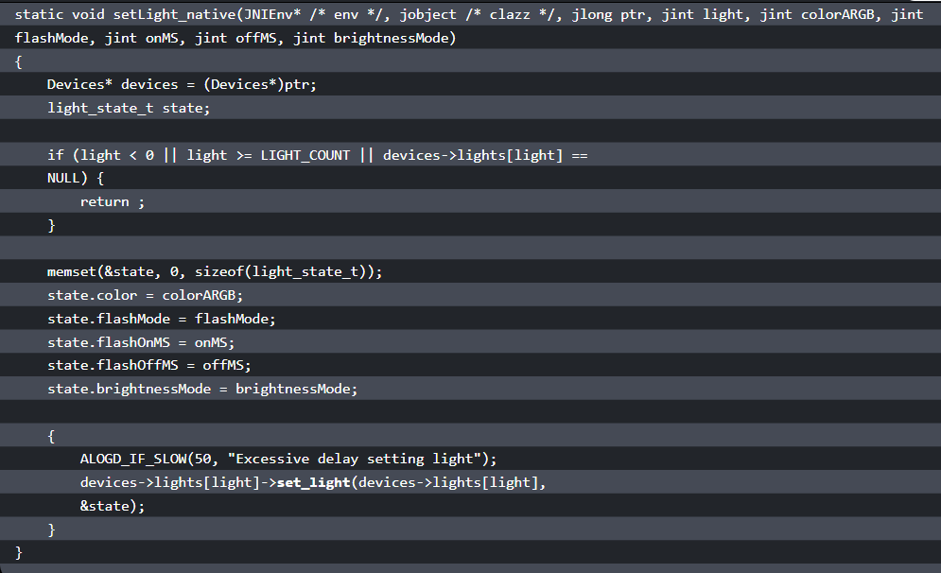
What is inside the AOSP?
Notes:
Now let's look at another native function, setLight_native:
In the setLight_native function, it gets the pointer of the data structure Devices first. After that, it calls the HAL function set_light to do the actual work.

Slide 88
The system service and hardware manager
Finally, let's look at the implementation of the native method, finalize_native:
static void finalize_native(JNIEnv* /* env */, jobject /* clazz */, jlong ptr)
{
Devices* devices = (Devices*)ptr;
if (devices == NULL) {
return;
}
free(devices);
}
Notes:
We can see that the finalize_native function just frees all resources used.

Slide 89
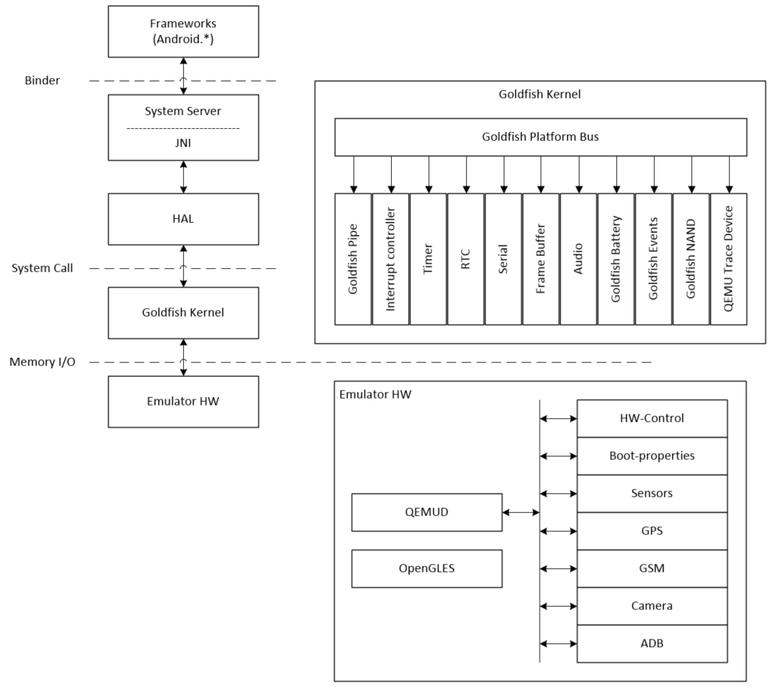
Android emulator kernel and hardware
Notes:
We use goldfish lights as an example to perform the calling sequence analysis from an application to the goldfish HAL. Now we can look at the kernel layer and the underlying hardware. We can also take an overview from the top to the bottom again to understand how the entire system works.
We use the preceding figure to explain goldfish kernel and hardware in detail. As you can see, the preceding figure is similar to the architecture diagram that we saw in lesson 1, Introduction to Android System Programming. This architecture diagram is the general architecture diagram for Android, but the preceding figure is specific to goldfish.
From the diagram, we can see the parts that we are interested in the goldfish kernel and emulator hardware. From the top to the bottom, the application utilizes the Android framework to implement functionalities and access the hardware. The framework usually resides in a different process from the system service layer, so they use Binder IPC to communicate with each other. The system service talks to the HAL using JNI, since HAL usually implements in the native language. The HAL is the user space implementation of hardware control and it communicates to the device driver in the kernel space through system calls. In the case of the goldfish hardware, the device driver accesses the virtual hardware through memory I/O registers, as we will see in the following section on Android emulator hardware.

Slide 90
Android emulator hardware
Unlike real hardware, most Android emulator hardware interfaces are emulated using QEMU, which is a popular open source emulator engine used by many open source projects.
The Android development team customized QEMU and added a virtual hardware platform called goldfish.
Notes:
As we mentioned in lesson 2, Setting Up the Development Environment, there are currently two versions of Android emulator available in the latest SDK.
The code name for the original Android emulator is goldfish and the new one is ranchu. However, the virtual hardware code base for device emulation in QEMU is the same for both versions.
Detailed information about goldfish hardware interfaces can be found in the document GOLDFISH-VIRTUAL-HARDWARE.TXT. This document can be found in the AOSP source code at $AOSP/platform/external/qemu/docs/GOLDFISH-VIRTUAL-HARDWARE.TXT.
For different kernel versions, the hardware interfaces may have some differences. In this course, we will look at the Intel x86-based ranchu virtual hardware, which uses Android Linux version 3.10.0. Let's look at the goldfish devices that we will discuss in this lesson.

Slide 91
Goldfish platform bus
In the architecture diagram for goldfish, we have a detailed diagram for the kernel and goldfish hardware.
We can see that all goldfish devices are enumerated through the goldfish platform bus.
The platform bus is a special device that is capable of enumerating other platform devices found on the system to the kernel.
Notes:
This flexibility allows us to customize which virtual devices are available when running a given emulated system configuration. The following table defines goldfish platform bus registers.

Slide 92
QEMU pipe device
One of the most important emulated devices in goldfish hardware is the QEMU pipe device.
This is a special device that is totally specific to QEMU, but allows guest processes to communicate directly with the emulator with extremely high performance.
This is achieved by avoiding any in-kernel memory copies, relying on the fact that QEMU can access guest memory at runtime (under proper conditions controlled by the kernel).
Notes:
As we can see from the goldfish architecture diagram, many other hardware interfaces, such as GPS, sensors, basebands, cameras, and so on, are emulated through the QEMU pipe. The following table defines QEMU pipe device registers.

Slide 93
Goldfish audio device
The goldfish audio device implements a virtual sound card with the following properties:
Stereo output at fixed 44.1 kHz frequency, using signed 16-bit samples, This is mandatory.
Mono input at fixed 8 kHz frequency, using signed 16-bit samples, This is optional.

Slide 94
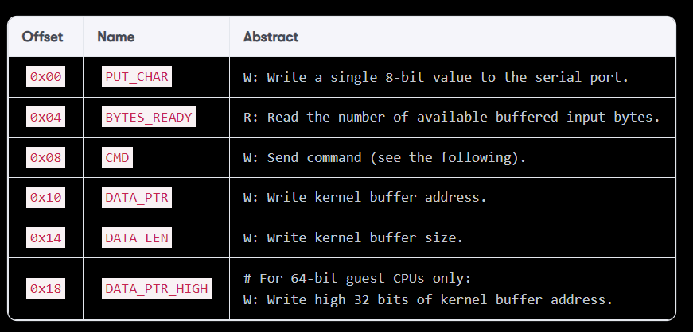
Goldfish serial port
The following table defines goldfish serial port registers:
Notes:
Android emulator has its own implementation of a virtual serial port. It always reserves the first two virtual serial ports:
The first one is used to receive kernel messages. This is done by adding the console=ttyS0 parameter to the kernel command line.
The second one is used to set up the legacy qemud channel, used on older Android platform revisions. This is done by adding android.qemud=ttyS1 on the kernel command line. The qemud channel is implemented as a Linux daemon process used as a channel between the guest and emulator. In the latest emulator version, a QEMU pipe is used instead of qemud.

Slide 95
Goldfish serial port
The CMD I/O register is used to send various commands to the device, identified by the following values:
0x00 CMD_INT_DISABLE Disable device.
0x01 CMD_INT_ENABLE Enable device.
0x02 CMD_WRITE_BUFFER Write buffer from kernel to device.
0x03 CMD_READ_BUFFER Read buffer from device to kernel.
Notes:
Each device instance uses one IRQ, raised to indicate that there is incoming/buffered data to read.

Slide 96
Goldfish kernel
Goldfish kernel can be downloaded from the AOSP source repository.
You can download and build the kernel source code using the following command:
$ git clone https://android.googlesource.com/kernel/goldfish.git
$ cd goldfish
$ git checkout -b android-goldfish-3.10 origin/android-goldfish-3.10
$ make i386_ranchu_defconfig
$ make

Slide 97
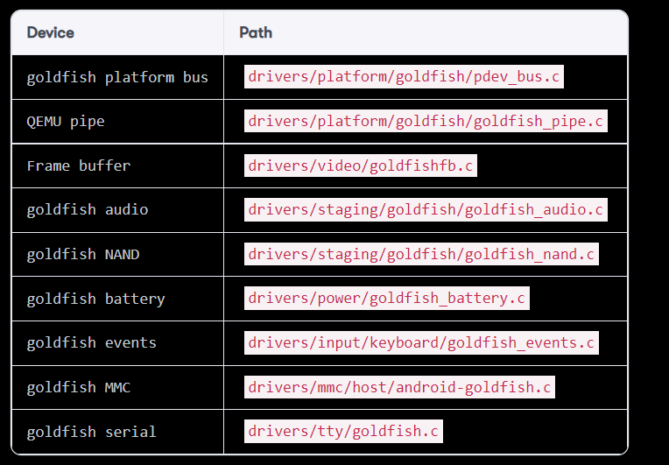
Notes:
The following table is a list of goldfish device drivers. This is based on kernel version 3.10.0. At the moment, kernel version 3.10.0 is for ranchu and 3.4.67 is for goldfish. The following table lists some goldfish specific devices. In ranchu, Virtio devices are used as block devices to simulate EMMC. Virtio devices are paravirtualized devices in QEMU that have better performance than emulated hardware devices.

Slide 98
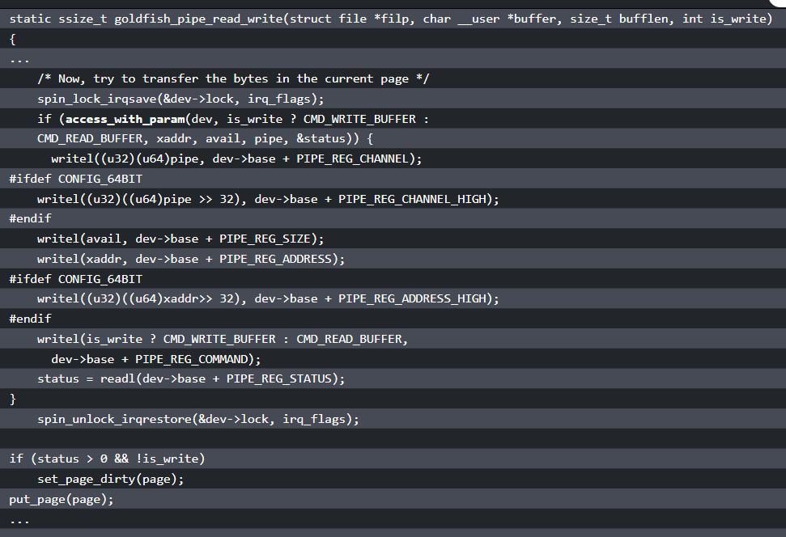
QEMU pipe
Notes:
Since QEMU pipe is used as a channel to emulate many goldfish devices, we can review one of the major functions, goldfish_pipe_read_write, to understand data transmission between guest and host:
As we can see from the preceding code, it invokes the access_with_param function first. This is the fastest way to transfer data between the guest and emulator using shared memory. With this method, the goldfish kernel allocates a piece of memory at boot time. The guest and emulator will use this shared memory to transfer parameters between them.

Slide 99
QEMU pipe
If the access_with_param function fails, it will use the following sequence to transfer data through the QEMU pipe device:
write_channel(<channel>)
write_address(<buffer-address>)
REG_SIZE = <buffer-size>
REG_CMD = CMD_WRITE_BUFFER/CMD_READ_BUFFER
status = REG_STATUS

Slide 100
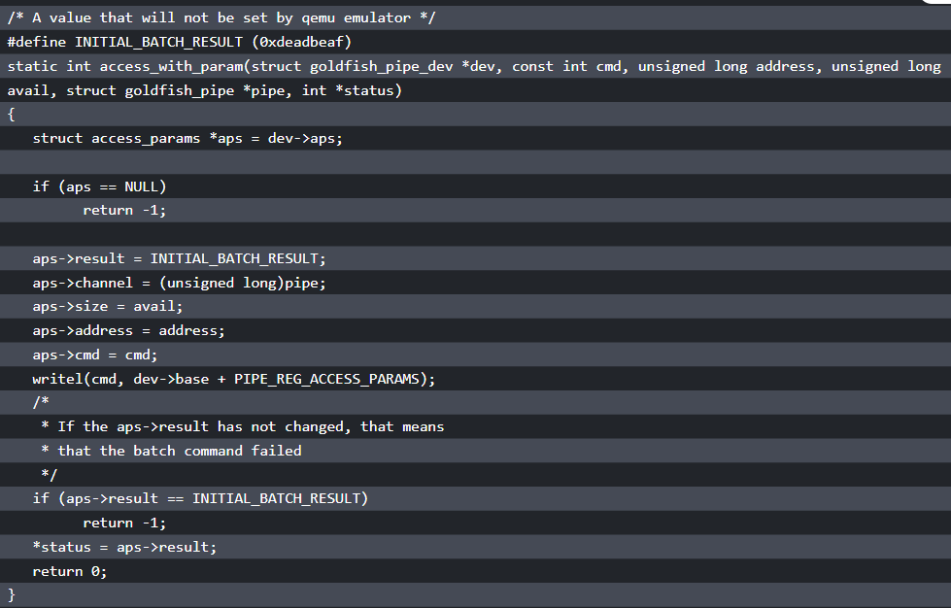
QEMU pipe
Notes:
Now let's take a look at the access_with_param function as follows:
The address of aps is the pre-allocated shared memory between the guest and emulator. All data structures that need to be used for a single operation are filled in this data structure aps. The command will be written to register PIPE_REG_ACCESS_PARAMS. The write to PIPE_REG_ACCESS_PARAMS will trigger the operation. QEMU will read the content of the access_params block, use its fields to perform the operation, and then write back the return value into aps->result. The difference between shared memory aps and the QEMU pipe device is similar to DMA and register-based device I/O. The shared memory or DMA is much more efficient in large blocks of memory access.
You can explore the rest of the goldfish device drivers by yourself.

Slide 101
Summary
In this lesson, we introduced the content of the AOSP source code.
After that, we used goldfish lights HAL as an example to analyze the calling sequence from the application to HAL.
Finally, we reviewed the Android architecture again using the Android system for the emulator.
We also reviewed goldfish kernel and hardware to understand how they work together with the rest of the software stacks.
Notes:
In the next lesson, we will start to work on our own x86emu device and use it to explore how to extend an emulator to support additional functionalities.

Slide 102
Customizing the Android Emulator

Slide 103
Customizing the Android Emulator
In this lesson, we will cover the following topics:
Why customize the Android emulator?
Creating a new x86emu device
Building and testing the new x86emu device
Notes:
In the last lesson, we spent some time exploring the details of the Android system architecture. With our knowledge about kernel, HAL, and system service, we can start to customize the Android system ourselves.

Slide 104
Why customize the Android emulator
You may be wondering why we want to customize Android emulator.
Google already provides it in the Android SDK and we can just use it without any additional effort.
However, as a developer, you may find that it may not be good enough to meet your expectations.
Notes:
For example, in the most recent Android Studio or SDK releases, the Intel x86 emulator is recommended for developers, since it is much faster than the ARM version. One problem with using the Intel x86 emulator is that many Android applications with native code cannot run properly, because the x86 native library is not built into these applications.
To resolve this issue, we can integrate Houdini libraries from Intel to the emulator. With Houdini libraries, we can execute ARM native code on the Intel x86 platform. Another common request for Android emulator is that Google Mobile Services (GMS) is not included in it. Many developers develop applications with the assumption that GMS should be available on the device. In the next few lessons, we will learn how to create a x86emu device to customize Android emulator so that we can integrate components such as Houdini or enable additional hardware interfaces, such as Wi-Fi, in Android emulator. Armed with the knowledge about how to create the x86emu device, you can create your own Android emulator to meet your requirements.
It is possible, we always avoid changing too much AOSP code directly. This is because the more we change, the harder it is for us to port it to the latest version of Android. Google constantly releases new Android code from time to time. Sometime, new releases may be difficult to merge because of the architecture change.
From this lesson to lesson 7, Enabling Wi-Fi on the Android Emulator, we will teach a way to customize existing devices with minimal changes to the AOSP source code. From lesson 8, Creating Your Own Device on VirtualBox to lesson 11, Enabling VirtualBox-Specific Hardware Interfaces, we will discuss the porting to a new platform that we have to change to AOSP code directly. Even in that case, we still have to plan and consider the merge effort to a new Android release.

Slide 105
Understanding build layers
The AOSP build system includes the abstraction layers to build a device.
After we understand the ideas behind these layers, it will help us to understand the relationship of the various Makefiles for a device.
It is always good to refer to the original Google document at the following URL, when you start to create a new device.
Notes:
The information will usually be updated when a new Android release is available: http://source.android.com/source/add-device.html.
In this section, we will apply the information from the previous Google document to the specific Android emulator virtual hardware that we are going to work on. In this way, we can derive all device-specific Makefiles according to the general guidance from the previous Google document. Throughout the process from generic to specific, we can apply the inheritance of object-oriented concepts to the Makefile system.
There are three layers, Product, Board/Device, and Architecture, in the device build system. These layers can be considered as different dimensions to measure the characteristic of a product. Each layer relates to the one above it in a one-to-many relationship, which is similar to the inheritance or composition relationship in the object-oriented terms. For example, one kind of hardware architecture can have more than one board and each board can have more than one product. We will see how this method works when we create a new device in this lesson later.

Slide 106
Build variants
When building for a particular product, it's often useful to have minor variations on what is ultimately the final release build.
By using different build variants, it can help the different parties in the product development cycle.
There are primarily three kinds of build variant in the AOSP so far, The engineering build is the default one and is suitable for development work.
Notes:
In this type of build, the product security policy is not fully enforced and the debugging mechanisms are turned on. It is easy for engineers to test and fix issues with an engineering build.
The second flavor is user build, which is used for the final release. All debugging mechanisms are turned off and the product security policy is fully enforced. The third flavor is userdebug, which is in between the engineering build and user build. This type of build can be used in the field test, which is also used by the end users.
All components in the AOSP build are called modules. In a module definition, the module can specify tags with LOCAL_MODULE_TAGS, which can be one or more values of optional (default), debug, or eng. With a tag, we can define the usage of a module. For example, all debug tools will only be included in the engineering build.
If a module doesn't specify a tag (by LOCAL_MODULE_TAGS), its tag defaults to optional. An optional module is installed only if it is required by product configuration with PRODUCT_PACKAGES. We usually specify packages needed by a product in the device Makefile using the PRODUCT_PACKAGES variable. This way, we can easily define modules that are only suitable for a particular build.

Slide 107
Creating a new x86emu device
To customize Android emulator, we need to create a new device based on Android emulator and make our customization on this new device.
We will work on this from the original AOSP source code.

Slide 108
Checking out from the AOSP
$ mkdir android-x86emu
$ cd android-x86emu
$ repo init -u https://android.googlesource.com/platform/manifest -b android-7.1.1_r4
$ repo sync
$ git clone https://github.com/shugaoye/goldfish.git -b android-7.1.1_r4_x86emu_ch04_r1 kernel
$ cd device/generic
$ git clone https://github.com/shugaoye/x86emu.git -b android-7.1.1_r4_x86emu_ch04_r1
Notes:
As I mentioned before, I try to avoid unnecessary changes to the AOSP source code as much as I can. In this lesson, in order to set up the build environment, you can check out the android-7.1.1_r4 version of the AOSP source code and clone the kernel and x86emu source to the AOSP source tree as follows:
Now we have retrieved the source code step by step. The project x86emu is the new device that we create in this lesson and can be used to customize Android emulator in the next few lessons. The goldfish project is the kernel that I forked from the AOSP goldfish kernel: https://android.googlesource.com/kernel/goldfish/.
The android-7.1.1_r4_x86emu_ch04_r1 tag is the baseline of this lesson's source code release. All source code created or changed in this course is baselined using the naming convention {Android version}_{project}_{lesson number}_{release number}. Here is the explanation of this naming convention:
Android version is the original AOSP version number
project can be x86emu or x86vbox
lesson number is what lesson we create a baseline for the source code
release number is used to indicate the number of releases
These can work in the simple configuration of this lesson. This method is not good enough when we use source code from multiple sources as we will do in other lessons later in this courses. We will use our own manifest file to manage the source code in this course.

Slide 109
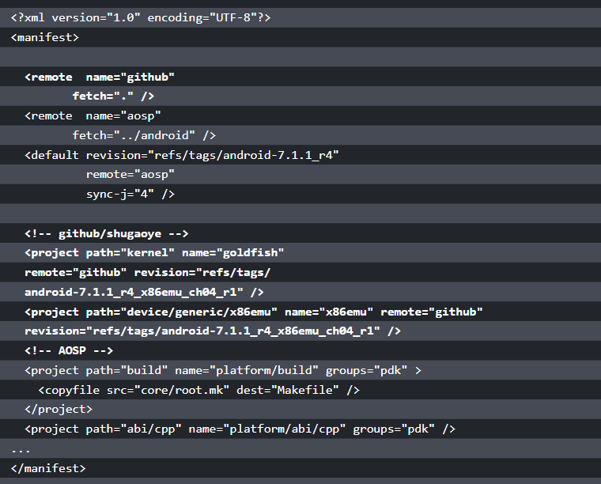
Checking out from a local mirror
Notes:
To use our own manifest file, we can use either a local mirror or a remote repository. If we use a local mirror, we have to change manifest.xml of android-7.1.1_r4 a little to make our own. We copy .repo/manifest.xml to our manifests/default.xml and make the following changes:

Slide 110
Checking out from a local mirror
Manifest file has an assumption that our local mirror has the following directory structure:
$ ls -F
android/ android-x86/ github/
Notes:
The AOSP mirror is created under the android folder. GitHub mirror is created under the github folder. We need to use android-x86 source code as well later. We can put it under the android-x86 folder. Our own manifest is stored at github/manifests and the preceding manifest file is github/manifests/default.xml. In this file, we add additional lines to retrieve the Android kernel and x86emu device from GitHub.

Slide 111
Checking out from a local mirror
With this manifest, we can get the source code using the following command:
$ mkdir android-x86emu
$ cd android-x86emu
$ repo init -u {your mirror URL}/github/manifests.git -b android-7.1.1_r4_ch04
$ repo sync

Slide 112
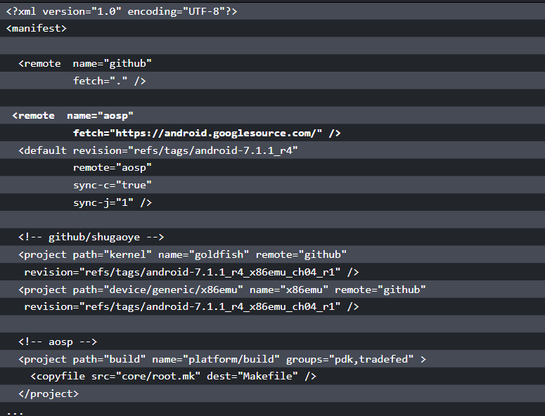
Checking out from a local mirror
Notes:
We can also retrieve all source code from the remote repository directly using our own manifest file. With that, we need to change the manifest file a little as follows:

Slide 113
Checking out from a local mirror
we changed the URL of the remote aosp to use the absolute path in this revision of the manifest file.
To check out the source code using this revision, we can run the following commands:
$ mkdir android-x86emu
$ cd android-x86emu
$ repo init -u https://github.com/shugaoye/manifests -b android-7.1.1_r4_ch04_aosp
$ repo sync
Notes:
Because there are multiple repositories involved in this course, I strongly encourage you to use a local mirror. This can make the build and debug process more efficient.
It is also possible to use local_manifests to set up your workspace. You can refer to Appendix B, Using Repo in This Book, in the course Embedded Programming with Android. A sample file can be found at https://github.com/shugaoye/build/blob/master/local_manifest.xml.
In this course, I use branches for the manifest file to manage the different versions of source code. To create a baseline of the source code in a lesson, I use the following naming convention:
{Android version}_{lesson number}_{remote (optional)}
Android version is the original AOSP version number
lesson number is what lesson we create a baseline for the source code
remote is used to indicate how to check out the source code from the remote repositories

Slide 114
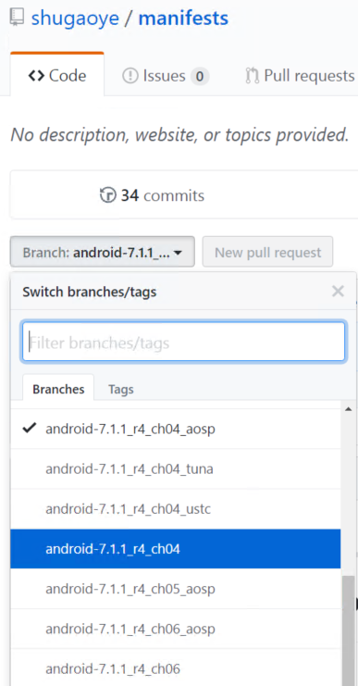
Checking out from a local mirror
Notes:
For example, from the following screenshot, we can see that the branch android-7.1.1_r4_ch04 is used to check out the source code of lesson 4 from a local mirror. The branch android-7.1.1_r4_ch04_aosp is used to check out the source code for lesson 4 from the remote repository. Since I am in China, I don't have access to the AOSP source code all the time. I created revisions (android-7.1.1_r4_ch04_tuna and android-7.1.1_r4_ch04_ustc) for lesson 4 to check out the source code from AOSP mirrors in China and GitHub. You may change the manifest file according to your needs.

Slide 115
Creating x86emu device
The hierarchy in the device folder is in the vendor-name/device-name format.
For example, the Nexus S from Samsung can be found in the samsung/crespo folder.
The device name of Nexus S is crespo. We can create our device under a common folder, generic, as follows.
The folder name for our device is generic/x86emu:
$ cd device/generic
$ mkdir x86emu
Notes:
After we check out the source code, we can look at how to create a new x86emu device in the $AOSP/device folder.
This is the project that we create in this lesson and you can find the source code at https://github.com/shugaoye/x86emu.git.
We will create a list of Makefiles in this folder to build the device. Refer to the build layers in the previous section. Here is a list of Makefiles that need to be included in the device skeleton:
AndroidProducts.mk: This is a Makefile to describe the various products that can be built for this device
BoardConfig.mk: This is a board configuration Makefile for the hardware board
device.mk: This is the device Makefile that is used to declare the files and modules needed for the device
vendorsetup.sh: This is a shell script that can be used to add your product (a "lunch combo") to the build along with a build variant separated by a dash
{Product Makefile}.mk: This is the product definition Makefile and it is used to create a specific product based on the device
Now we can create Makefiles for our device one by one according to the preceding list.

Slide 116
AndroidProducts.mk
We included all product definition Makefiles in this file.
The AOSP build system will start to search all product definitions using this file.
The following is the content of AndroidProducts.mk:
PRODUCT_MAKEFILES := \
$(LOCAL_DIR)/x86emu_x86.mk \
$(LOCAL_DIR)/x86emu_x86_64.mk \
Notes:
As we can see, we defined two product variants for x86 and x86_64 builds.
Both x86emu_x86.mk and x86emu_x86_64.mk are very similar. They define the same set of product definition variables for 32 bit and 64 bit.

Slide 117
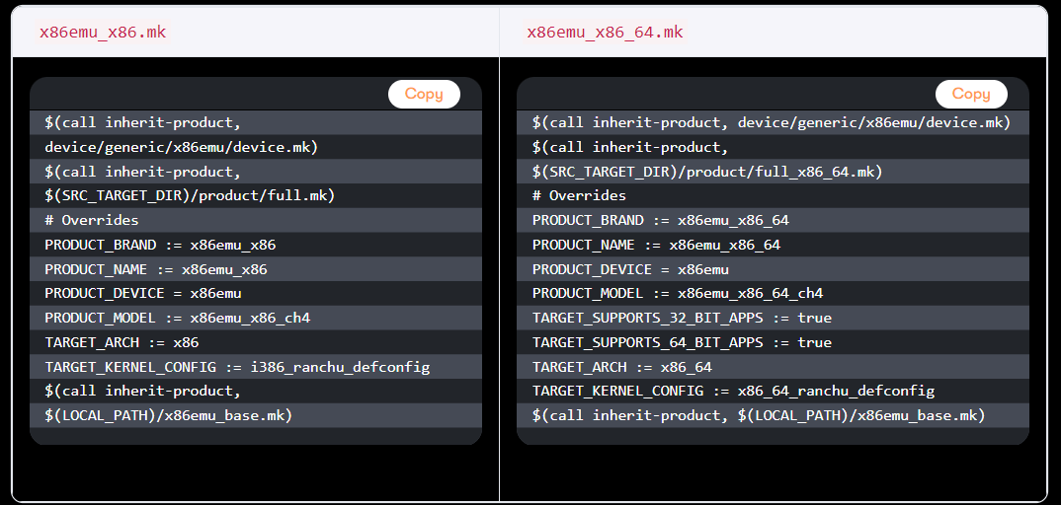
AndroidProducts.mk
Notes:
The following table compares the product definition Makefiles for 32-bit and 64-bit build:

Slide 118
AndroidProducts.mk
You may notice that we inherit the common product definition files for 32-bit and 64-bit first at the beginning:
$(call inherit-product, $(SRC_TARGET_DIR)/product/full.mk)
And:
$(call inherit-product, $(SRC_TARGET_DIR)/product/full_x86_64.mk)

Slide 119
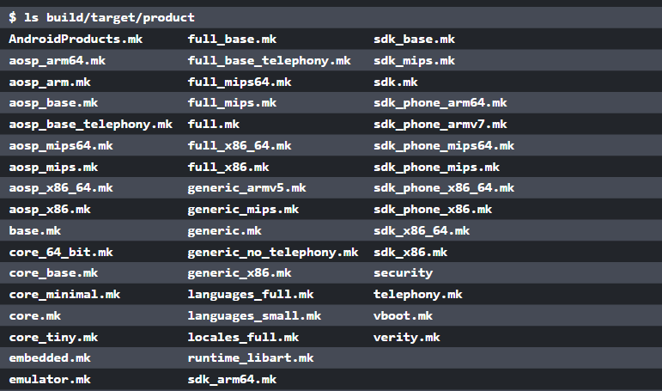
AndroidProducts.mk
Notes:
There are many generic product definitions defined by the AOSP build system. You can find them at $AOSP/build/target/product:
After that, a set of product definition variables PRODUCT_BRAND, PRODUCT_NAME, PRODUCT_DEVICE, and PRODUCT_MODEL are defined with different values. TARGET_ARCH and TARGET_KERNEL_CONFIG are also defined for 32 bit and 64 bit separately. Pay attention to PRODUCT_MODEL. Since we will change Makefiles in each lesson, in this course we use PRODUCT_MODEL to indicate the build for each lesson. In this lesson, we define PRODUCT_MODEL as x86emu_x86_ch4 for the build in this lesson.

Slide 120
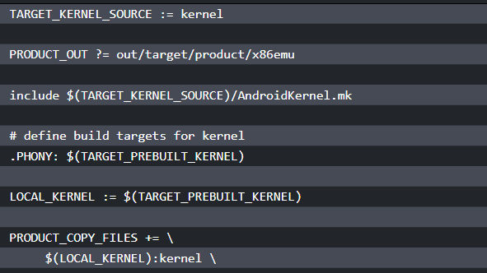
AndroidProducts.mk
Notes:
At the end of the file, we also include a common Makefile x86emu_base.mk for both 32-bit and 64-bit products. This file includes additional configurations for the kernel build:
The kernel build is usually not included in the AOSP build. You have to build them separately according to the instructions from Google. In this course, we integrate the kernel build in our own Makefile here. The kernel AndroidKernel.mk Makefile is created based on the Makefile of the Qualcomm kernel source at https://android.googlesource.com/kernel/msm/.
There are many product definition variables used in the preceding Makefiles. Let's review the product definition variables that we used here. Refer to the Google documents for the complete list:
PRODUCT_BRAND: This is the brand that the software is customized for. We just defined it as our device name.
PRODUCT_NAME: This is the product name that we give to the device. We set it to x86emu_x86 in this course. It is also the prefix that we can select in the lunch combo, such as x86emu_x86-eng. The suffix is the build variants.
PRODUCT_DEVICE: The name of the actual product. TARGET_DEVICE derives from this variable. This is also the board name that the build system uses to locate BoardConfig.mk. It is the x86emu for our device and it is also the directory name of our device at $AOSP/device/generic/x86emu.
PRODUCT_MODEL: This is the name that we can see in the settings in Model. As I mentioned earlier, we use this variable to differentiate the build of each lesson in this course.
PRODUCT_OUT: This is the output folder of the build result. It is the same as the environment variable $OUT.
PRODUCT_COPY_FILES: This is a list of specific files that we would like to copy to the target's filesystem. The list of words looks like source_path:destination_path. The file at the source path should be copied to the destination path during the build process.

Slide 121
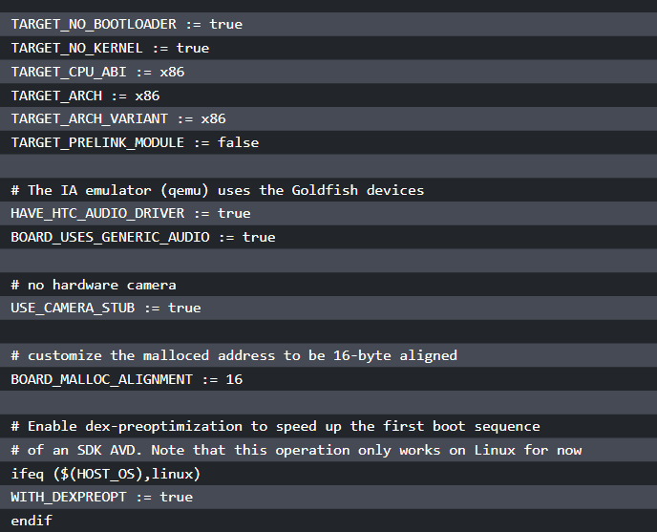
BoardConfig.mk
Notes:
BoardConfig.mk defines the board-specific configurations. We define CPU/ABI, the target architecture, OpenGLES configurations, and so on in this file. We also define the image file size, format, and so on:

Slide 122
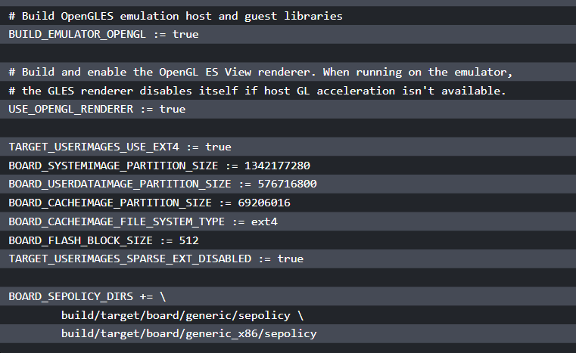
BoardConfig.mk
Notes:
This file is copied from a predefined AOSP board configuration at $AOSP/build/target/board/generic_x86/BoardConfig.mk with minor changes.

Slide 123
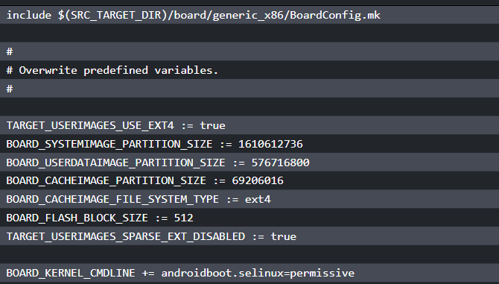
BoardConfig.mk
Notes:
We can also use the system-defined board configuration directly and overwrite predefined variables as follows:

Slide 124
BoardConfig.mk
If we look at the folder of $AOSP/build/target/board/generic_x86, it contains a few other files:
$ ls -F
BoardConfig.mk device.mk README.txt sepolicy/ system.prop
We need to copy system.prop to our device folder as well, since this file defines the Radio Interface Layer (RIL) configuration for the emulator as follows:
rild.libpath=/system/lib/libreference-ril.so
rild.libargs=-d /dev/ttyS0
Notes:
Without this, you will find that the data connection cannot work properly in the build.

Slide 125
device.mk
You may notice that there is a device.mk file in the generic_x86 folder. Yes, we can reuse that file directly.
The following is our device.mk file:
$(call inherit-product, $(SRC_TARGET_DIR)/board/generic_x86/device.mk)
Notes:
As we can see, in our device.mk file, we simply inherit the common device.mk from the generic_x86 device.

Slide 126
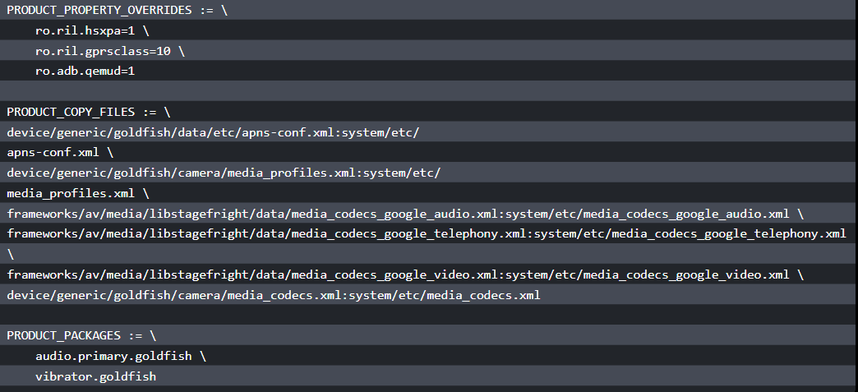
device.mk
Notes:
We can look at the device.mk file for the generic_x86 device as follows:

Slide 127
device.mk
Now we can add our device build to the build system using the following command:
$ add_lunch_combo <product_name>-<build_variant>
$ lunch <product_name>-<build_variant>
Such as:
$ add_lunch_combo x86emu_x86-eng
$ lunch x86emu_x86-eng
Notes:
In the preceding device.mk file for the generic_x86 device, it overwrites a few properties and copies configuration files to the system folder. It also includes the HAL layers for the goldfish device.

Slide 128
device.mk
To automatically add this to the build system, we can add a script vendorsetup.sh.
In this script, we can create all the build variants
for x86emu_x86:
for i in eng userdebug user; do add_lunch_combo x86emu_x86-${i} done
Notes:
Be aware that the 64-bit build for the x86emu device is not tested in this course. You must make the necessary changes by yourself if you want to test a 64-bit build.
In this section, besides product-level variables as I explained before, there are also variables for the target device and board-level variables. The following is a list of variables for the target devices that are defined in BoardConfig.mk, device.mk, or product definition Makefiles:
TARGET_ARCH: This is the architecture of the device. It is usually something such as arm, x86, and so on.
TARGET_USERIMAGES_USE_EXT4: This variable needs to be set as true to build a filesystem in ext4 format. The filesystem can be built into other formats such as yaffs2 in the older Android version prior to Android 4.4.
TARGET_KERNEL_SOURCE: This is the path for the kernel source code. In our case, the kernel source code can be found at $AOSP/kernel.
TARGET_KERNEL_CONFIG : The kernel configuration file that we use to build the kernel source.
The following is a list of board-level variables that we used in this lesson:
BOARD_SYSTEMIMAGE_PARTITION_SIZE: The size of the filesystem partition for the system image (system.img)
BOARD_USERDATAIMAGE_PARTITION_SIZE: The size of the filesystem partition for the user data (userdata.img)
BOARD_CACHEIMAGE_FILE_SYSTEM_TYPE: The filesystem format of cache partition
BOARD_FLASH_BLOCK_SIZE: The block size of the flash device

Slide 129
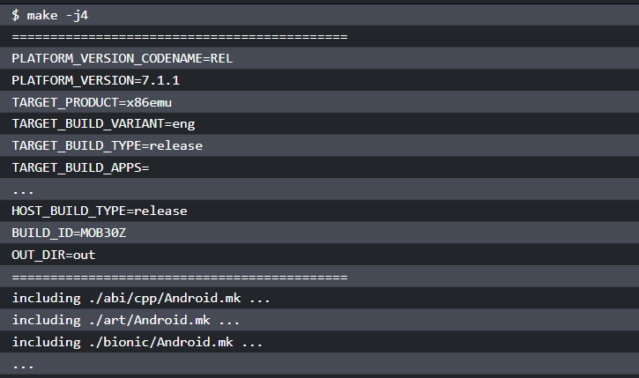
Building x86emu
Notes:
Building and testing x86emu
Once we have the source code, we can start to build and test our x86emu device in this section.
Before we start to build x86emu, let's have a quick look at the Android build system first. The major difference between the Android build system from other make-based build systems is that the Android build system doesn't rely on recursive Makefiles. Android Makefiles end in the extension .mk; the main Makefile for a particular source directory is named Android.mk. The build system imports all Android.mk from various folders to create one large Makefile to start the build, as we can see from the following code snippet:

Slide 130
Building x86emu
The Android build system provides a build/envsetup.sh script for the build environment setup.
We can set up the build environment by running the following command:
$ source build/envsetup.sh
After this, we need to specify the target that we want to build.
In Android build system terms, this is called a lunch-combo. We can specify a lunch-combo directly:
$ lunch x86emu_x86-eng
Notes:
Before we start the build, we must set up the build environment first.

Slide 131
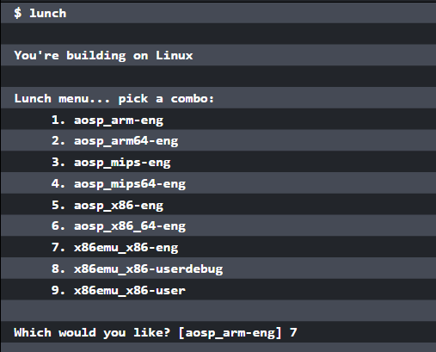
Building x86emu
Or select it from a list in a menu:

Slide 132
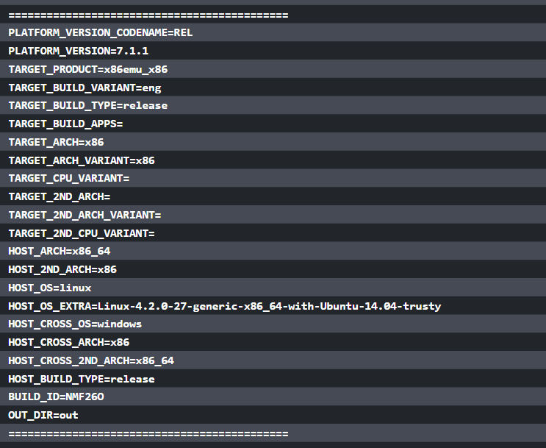
Building x86emu
Notes:
We learnt this in lesson 2, Setting Up the Development Environment, when we built the Android emulator image. You may notice that the difference here in the menu items is that the menu includes the device configurations added by us in this lesson.

Slide 133
Building x86emu
The lunch-combo that we select here is x86emu_x86-eng. We can start to build the target now using the following command:
$ make -j4
Or:
$ m -j4
Notes:
The -j4 option is used to specify the number of concurrent make sessions. It is related to the number of CPU cores that you have on your system, for example, you may choose -j8 in a more powerful hardware platform. The m command is available after we execute source build/envsetup.sh. It is equivalent to croot; make -j4.

Slide 134
Building x86emu
If you want to see the actual commands in the build, you can use the showcommands option on the command line:
$ make -j4 showcommands
Notes:
You may use other frequently used build targets. Here is a list of them that you may refer to in your build:
make sdk: Build the tools that are part of an SDK (adb, fastboot, and so on).
make snod: Build the system image from the current software binaries.
make all: Make everything, whether it is included in the product definition or not.
make clean: Remove all built files (prepare for a new build). It is the same as rm -rf out/<configuration>/.
make modules: Shows a list of submodules that can be built (a list of all LOCAL_MODULE definitions).
make <local_module>: Make a specific module (note that this is not the same as the directory name. It is the LOCAL_MODULE definition in the Android.mk file).
make clean-<local_module>: Clean a specific module.
make bootimage TARGET_PREBUILT_KERNEL=/path/to/bzImage: Create a new boot image with custom bzImage.
make recoveryimage: Make the recovery in bootable/recovery/.

Slide 135
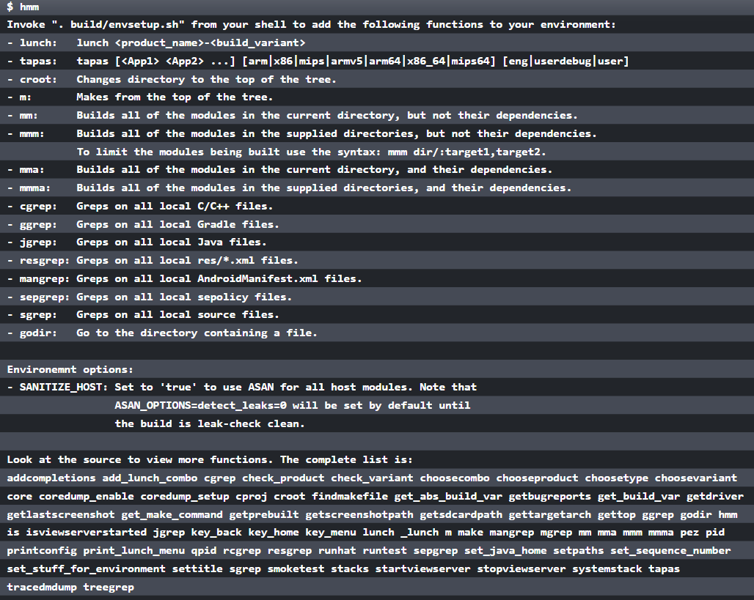
Building x86emu
Notes:
Besides the build targets, there are some helper macros and functions that are installed when you source envsetup.sh. You can find out what they are by using the hmm command:

Slide 136
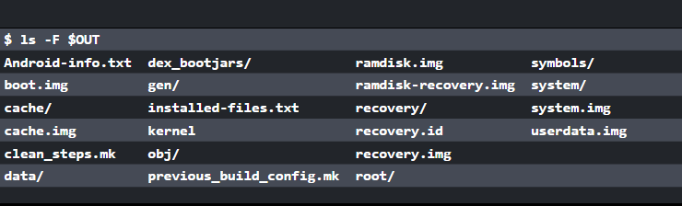
Building x86emu
Notes:
After we build the target successfully, we can find the images at out/target/product/x86emu in our case. We can also use the environment variable $OUT as follows to list the build output:

Slide 137
Testing x86emu
To use our own system images, we can create a shell script ~/bin/test-ch04.sh as follows:
#!/bin/sh
emulator @a25x86 -verbose -show-kernel -shell -selinux disabled -system ${OUT}/system.img -ramdisk ${OUT}/ramdisk.img -initdata ${OUT}/userdata.img -kernel ${OUT}/kernel
Notes:
To test x86emu, we can use the AVD a25x86 that we created in lesson 2, Setting Up the Development Environment.

Slide 138
Testing x86emu
You can see from the preceding shell script that the images for x86emu are used to start the AVD a25x86.
You need to set your Android SDK path so you can use the emulator from Android SDK:
$ test-ch04.sh

Slide 139
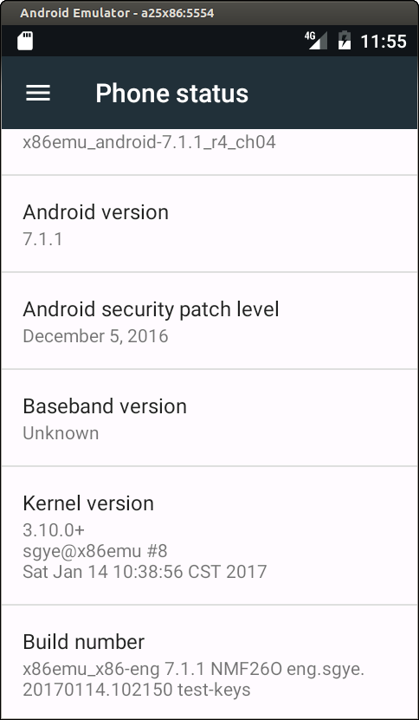
Testing x86emu
After you start the emulator, you can go to Settings | About phone to check the build information, as shown in the following screenshot:
Notes:
We can see from About phone that Model is x86emu_android-7.1.1_r4_ch04, which we specified in the product definition Makefile x86emu_x86.mk. Kernel version is 3.10.0 and Build number is the build target x86emu_x86-eng.
If you want to test the images in this lesson without setting up your own build, you can download the images from SourceForge at https://sourceforge.net/projects/Android-system-programming/files/android-7/ch04/.

Slide 140
Integrating with Eclipse
You may use an Integrated Development Environment (IDE) for your development work.
It is possible to integrate the AOSP build environment and selected projects into your favorite IDE.
Here, I will use Eclipse as an example to explain how to integrate our projects and AOSP build environment in Eclipse.
Be aware that since AOSP can only be built in the Linux environment, this can only work for Linux as well.
Notes:
Even though Android Studio is the default IDE for Android application development, I prefer Eclipse for Android system programming. With Eclipse, we can build both native and Java applications. We can also integrate AOSP builds in Eclipse projects.
To set up the Eclipse environment, you can use the latest Eclipse with ADT plugin or you can download an old ADT bundle from Google.
For Linux x86 or x86_64:
http://dl.google.com/Android/adt/adt-bundle-linux-x86_64-20140702.zip
http://dl.google.com/Android/adt/adt-bundle-linux-x86-20140702.zip

Slide 141
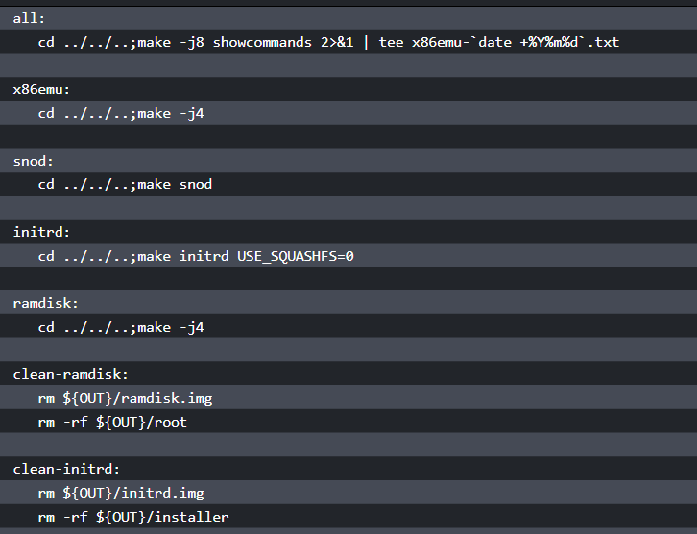
To use Eclipse, we need to create a Makefile for our x86emu device build as follows:
Notes:
We need to define a few build targets that can be used in Eclipse. Let's see how to import an x86emu device build into the Eclipse project. We will use Eclipse from the ADT bundle to explain the process.

Slide 142
Integrating with Eclipse
To integrate the AOSP build with Eclipse, we must launch Eclipse in the AOSP build environment.
Let's start Eclipse as follows:
$ source build/envsetup.sh
$ lunch x86emu_x86-eng
${SDK_ROOT}/eclipse/eclipse

Slide 143
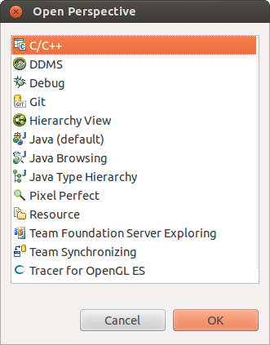
Integrating with Eclipse
Notes:
After we have installed the ADT bundle, we can find Eclipse in the preceding directory under the SDK installation path. After we launch Eclipse, select the C/C++ Perspective, as shown in the following screenshot:

Slide 144
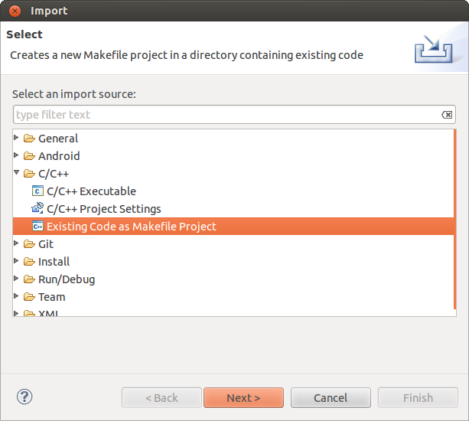
Integrating with Eclipse
Notes:
We can import the x86emu directory as an existing Makefile project to Eclipse by selecting File | Import... | Existing Code as Makefile Project, as shown in the following screenshot:

Slide 145
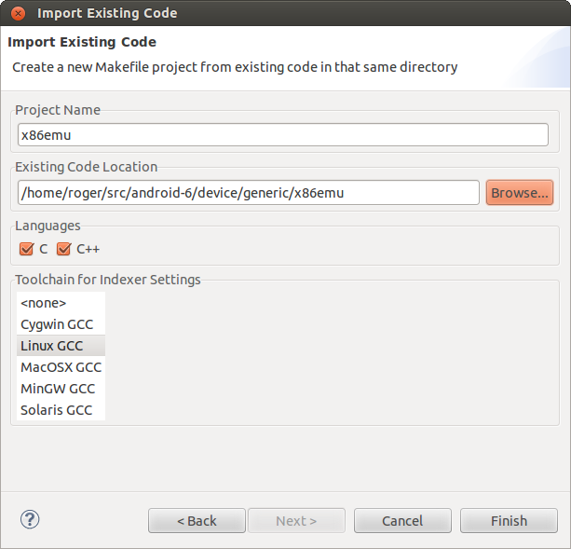
Integrating with Eclipse
Notes:
Click on Net and navigate to the $AOSP/device/generic/x86emu folder to import the source code, as shown in the following screenshot:
Once we import the project, we should be able to see that all files under the x86emu folder are shown on the right-hand side in Project Explorer, as we can see in the following screenshot. Then we can click the right mouse button to see the menu list for the project and select Make Targets | Create... | Create Make Target.

Slide 146
Integrating with Eclipse
We can add the build target that we defined in the Makefile in the Target name field.
If we define the default build target all, the default build in Eclipse will trigger the build target all in our Makefile.
This is what we defined for build target all:
all:
cd ../../..;make -j8 showcommands 2>&1 | tee x86emu-`date +%Y%m%d`.txt

Slide 147

Integrating with Eclipse
Notes:
What we do here is launch the AOSP build at the AOSP root directory. We also generate a log file for the build using a naming convention, x86emu-{$DATE}.txt, and you can find this log file at the AOSP root folder after the build is completed.

Slide 148
Summary
In this lesson, we learnt how to create a new device based on the Android emulator build for Intel x86 architecture.
We explained the different build layers in the AOSP built system and how these build layers associate with Makefiles for a device, After that, we build and tested the new x86emu device.
Notes:
Finally, to improve the efficiency of development work, we integrated the AOSP build in Eclipse. In the next lesson, we will extend Android emulator to support ARM binary translation using the x86emu device.

Slide 149
Enabling the ARM Translator and Introducing Native Bridge

Slide 150
Enabling the ARM Translator
and Introducing Native Bridge
In this lesson, we will cover the following topics:
Introducing Native Bridge
Integrating the Houdini library to the x86emu device
Building and testing the image with Houdini integration
Notes:
We created a new x86emu device in the last lesson. This is the foundation of further customization and extension. As we know, if the application includes native libraries, it cannot run on a different processor architecture. Most Android applications are built for the ARM platform. We usually have problems with running these applications with ARM native libraries on Intel x86 platform. However, Google provides a solution for this situation from Android 5 and above called Native Bridge. We will delve into the Native Bridge and Intel Houdini implementation to extend x86emu to support the ARM native application in this lesson.

Slide 151
Introducing Native Bridge
Native Bridge is implemented as a part of Android Runtime (ART) in the Android architecture.
It is used to support running native libraries in a different processor architecture so that an application with native libraries can run on a broader range of devices.
Notes:
The Intel ARM translator called Houdini is one of the use cases of Native Bridge. In ART, there are two stages for the Native Bridge to be initialized:
In the first stage, the Native Bridge is loaded in the system as part of the ART initialization process. This is common for all applications.
In the second stage, when an application with native libraries is started, it will be forked from Zygote. At this time, the Native Bridge will be initialized and ready to be used for the application. This is a process that is specific for individual applications. For example, if there are no native libraries being used, Native Bridge won't be initialized for this application.
Zygote Android at its core has a process they call the Zygote, which starts up at init. This process is a "warmed-up" process, which means it's a process that's been initialized and has all the core libraries linked in. When you start an application, the Zygote is forked to create the new process. The real speedup is achieved by not copying the shared libraries. This memory will only be copied if the new process tries to modify it. This means that all of the core libraries can exist in a single place because they are read-only.

Slide 152

Introducing Native Bridge
Notes:
When the application starts to load a native library from a different processor architecture, the Native Bridge will help to resolve the loading of this library. For example, when we load an ARM library on Intel the x86 architecture, the Native Bridge will use Houdini to load and execute this ARM library in the Intel x86 environment.

Slide 153
Introducing Native Bridge
Within the Native Bridge implementation, it has five states defined in native_bridge.cc, as follows:
enum class NativeBridgeState {
kNotSetup, // Initial state.
kOpened, // After successful dlopen.
kPreInitialized, // After successful pre-initialization.
kInitialized, // After successful initialization.
kClosed // Closed or errors.
};
Notes:
Native Bridge is built as a libnativebridge.so shared library as part of the Android system libraries, as shown in the preceding diagram. The implementation can be found at $AOSP/system/core/libnativebridge.
When the Android system has just started, Native Bridge is in a kNotSetup state. During the initialization of ART, it will be loaded into the system and the stage changes to kOpened.
These two states are in the first stage of the Native Bridge initialization. When the user starts an application with native libraries, the system will fork a new process from Zygote. At this time, the system will do some pre-initialization work for Native Bridge, and we will see this later in this lesson. The state changes to kPreInitialized at this time. After the process is forked from Zygote, Native Bridge is initialized as part of the process creation and its state becomes kInitialized. The kClosed state is usually not used unless there is an error and Native Bridge is closed. These three states fall into the second stage of the Native Bridge initialization.
With the overview about Native Bridge in Android system architecture, we will have to delve into the details of each stage about Native Bridge used at runtime.

Slide 154

Setting up Native Bridge as part
of the ART initialization
Notes:
First of all, let's take a look at how Native Bridge is loaded in the system. Native Bridge is loaded as part of the initialization of ART. As shown in the following diagram, it includes function calls from ART to the Native Bridge implementation. At the end of this stage, the state of Native Bridge will be set to kOpened.

Slide 155

Setting up Native Bridge as part
of the ART initialization
Notes:
When the system is initializing ART, the Runtime::Init function is called. Inside Runtime::Init, a LoadNativeBridge function is invoked to load the Native Bridge shared library. We can see this in the following code snippet:
This LoadNativeBridge function is part of ART and it is implemented in the native_bridge_art_interface.cc file, as shown in the following snippet. This function simply calls to another function, android::LoadNativeBridge, in the namespace android, while it itself is in the namespace of art. The functions in the namespace of android are part of the Native Bridge implementation, as shown in the preceding diagram, and we will see more of this later in this lesson.

Slide 156

Setting up Native Bridge as part
of the ART initialization
Notes:
We can see the implementation of LoadNativeBridge in the following code snippet:
The android::LoadNativeBridge function in the android namespace has an extra native_bridge_art_callbacks parameter compared to the art:LoadNativeBridge function in the art namespace. The type of this parameter is a pointer of struct NativeBridgeRuntimeCallbacks, which is defined in native_bridge.h

Slide 157

Notes:
. In struct NativeBridgeRuntimeCallbacks, it defines three callback methods as follows:

Slide 158

Notes:
These three callback functions that are part of ART are implemented in the native_bridge_art_interface.cc file. These callback functions provide a way for native methods to call JNI native functions. We will see how this callback data structure is passed to the actual Native Bridge implementation later. In our case, the actual implementation is the Houdini library.

Slide 159

Setting up Native Bridge as part
of the ART initialization
Notes:
The native_bridge.h file defines another callback function data structure, NativeBridgeCallbacks, which is used as the Native Bridge interface of its actual implementation. In our case, this implementation is the Houdini library. The Houdini library needs to implement these callback functions and pass the pointers to Native Bridge so that ART can use them. The following figure depicts the relationship between these two groups of callback functions:

Slide 160

Notes:
In the preceding figure, we can see that ART calls Native Bridge functions to load and initialize the Native Bridge module. The Native Bridge module invokes the callback functions registered by Houdini to handle all ARM native binary translations. During the initialization of Native Bridge, NativeBridgeRuntimeCallbacks are passed to the Houdini library so that the methods in the Houdini library can call JNI native functions.
Now let's take a look at the implementation of android::LoadNativeBridge:

Slide 161

Notes:
As we can see from the preceding code snippet, android::LoadNativeBridge checks the state first. It should be in a kNotSetup state. Otherwise, it will report an error and return.
To be convenient, we will refer to the function in the Android namespace as LoadNativeBridge instead of android::LoadNativeBridge in the next few paragraphs. The files that will be discussed can be found at: $AOSP/art/runtime/runtime.c $AOSP/art/runtime/native_bridge_art_interface.c $AOSP/system/core/libnativebridge/native_bridge.cc
After that, it will check whether the first parameter is NULL and the filename is good to use or not. If everything is good, it will open the library through dlopen using the filename nb_library_filename.

Slide 162
Setting up Native Bridge as part
of the ART initialization
what is the content of the nb_library_filename filename? As we can see from the Runtime::Init function, the first parameter of LoadNativeBridge is initialized using a Opt::NativeBridge property:
std::string native_bridge_file_name = runtime_options.ReleaseOrDefault(Opt::NativeBridge);
Notes:
This property is initialized from the default property ro.dalvik.vm.native.bridge, which is defined in the default.prop file of the Android system. This is done in the AndroidRuntime::startVm function, as you can see in the following snippet.

Slide 163

Setting up Native Bridge as part
of the ART initialization
Notes:
function is defined in the $AOSP/frameworks/base/core/jni/AndroidRuntime.cpp file:
When Native Bridge is enabled, the ro.dalvik.vm.native.bridge property usually includes a shared library filename. In our case, it is libhoudini.so for Intel devices or libnb.so for Android-x86. If Native Bridge is disabled, its value is 0. Once the library is loaded successfully, it will use the kNativeBridgeInterfaceSymbol symbol to get the memory location and cast the location to a pointer of NativeBridgeCallbacks. This means that the Houdini library provides an implementation of NativeBridgeCallbacks

Slide 164

Setting up Native Bridge as part
of the ART initialization
Notes:
Let's look at what it is inside NativeBridgeCallbacks:
From the preceding code snippet, we can see that NativeBridgeCallbacks includes a variable and seven callback functions:
version: This is the version number of the interface. So far, there are two versions. Version 1 defines the first five callback functions and version 2 adds another two new functions, which we will see very shortly.
initialize: This function initializes an instance of Native Bridge. Native Bridge's internal implementation must ensure multithread safety and Native Bridge is initialized only once.
loadLibrary : This function loads a shared library that is supported by the Native Bridge.
getTrampoline : This function gets a Native Bridge trampoline for the specified native method.
isSupported : This function checks whether the instance of Native Bridge is valid and whether it is for an ABI that is supported by Native Bridge.
In version 2, the following two functions are added:
isCompatibleWith: This function checks whether the bridge is compatible with the given version of library. A bridge may decide not to be forward- or backward-compatible, and libnativebridge will then stop using it.
getSignalHandler: A callback function to retrieve a Native Bridge's signal handler for the specified signal. The runtime will ensure that the signal handler is being called after the runtime's own handler, but before all chained handlers. The native bridge should not try to install the handler by itself, as that will potentially lead to cycles.
Now we have concluded the first stage of the Native Bridge initialization. As we can see from the preceding lists, Native Bridge is loaded at the startup of ART. At this stage, the initialization is not process-specific. The library name is defined in the ro.dalvik.vm.native.bridge property. In our case, ART loads the libhoudini.so library through the LoadNativeBridge function defined in libnativebridge.so. After Native Bridge is loaded successfully, the state is set to kOpened.

Slide 165

Pre-initializing Native Bridge
Notes:
In the second stage of Native Bridge initialization, it becomes process-specific. Native Bridge can be used by an Android application to load a native library in a different processor architecture than the current device. The other two states, kPreInitialized and kInitialized, are related to the creation of Android applications, as we know that all applications are forked from Zygote in Android. Let's look at the pre-initialization of Native Bridge first, as shown in the following diagram:

Slide 166

Pre-initializing Native Bridge
Notes:
During the creation of an application, the ForkAndSpecializeCommon function is called. The pre-initialization of Native Bridge is done in this function. This function is defined in the $AOSP/frameworks/base/core/jni/com_android_internal_os_Zygote.cpp file:

Slide 167

Pre-initializing Native Bridge

Slide 168

Pre-initializing Native Bridge

Slide 169
Pre-initializing Native Bridge
bool NeedsNativeBridge(const char* instruction_set) {
if (instruction_set == nullptr) {
ALOGE("Null instruction set in NeedsNativeBridge.");
return false;
}
return strncmp(instruction_set, kRuntimeISA,
strlen(kRuntimeISA) + 1) != 0;
}
Notes:
In this ForkAndSpecializeCommon function, it checks whether the current process is not a SystemServer process and if the Native Bridge is ready to use. After that, it calls the NeedsNativeBridge function to check whether the current process needs to use Native Bridge or not:
The NeedsNativeBridge function compares instruction_set with the current Android platform instruction set. If these two instruction sets are different, then we need to use Native Bridge; otherwise, we don't. The NeedsNativeBridge function is implemented in native_bridge.cc.

Slide 170

Pre-initializing Native Bridge
Notes:
If Native Bridge is needed by the application, then PreInitializeNativeBridge, which is also implemented in native_bridge.cc, is going to be called with two parameters, app_data_dir_in and instruction_set:

Slide 171

Pre-initializing Native Bridge

Slide 172

Pre-initializing Native Bridge
Notes:
From the preceding code snippet, we can see that it will check whether the state is kOpened or not. Then PreInitializeNativeBridge will do two things. Firstly, it creates a code cache directory using the first parameter, app_data_dir_in, for Native Bridge in the data folder of the application. Next, it uses the second parameter, instruction_set, to find the /system/lib/<isa>/cpuinfo path and it does a bind-mount of it to /proc/cpuinfo. If Houdini is available in the device, you can find the /system/lib/arm/cpuinfo file in the system folder. Once the preceding two tasks are completed, the state of Native Bridge will be set to kPreInitialized.

Slide 173

Initializing Native Bridge
Notes:
After the state is changed to kPreInitialized, the creation of the new Android application will continue in the ForkAndSpecializeCommon function. At the end of this function, it calls a callPostForkChildHooks registered function through a global variable, gCallPostForkChildHooks. The call stack will eventually go to a ZygoteHooks_nativePostForkChild function, which is the JNI implementation of the postForkChild Java method. The postForkChild function is called by Zygote in the child process after every fork. The following table is a summary of the call stack:
The ZygoteHooks_nativePostForkChild function is implemented in the $AOSP/ art/runtime/native/dalvik_system_ZygotHooks.cc file. The DidForkFromZygote function is implemented in the $AOSP/art/runtime/runtime.cc file.

Slide 174

Initializing Native Bridge
Notes:
The following diagram is a summary of functions involved in the second stage of the initialization of Native Bridge. Be aware that we are in the child process now. We can see that the Runtime::DidForkFromZygote function in ART will call the following Native Bridge interface functions: InitializeNativeBridge and SetupEnvironment. The Native Bridge interface functions will eventually call the registered callback functions in the Houdini library.

Slide 175

Initializing Native Bridge
Notes:
Let's look at the JNI implementation of postForkChild:

Slide 176

Initializing Native Bridge
Notes:
Here, it checks the instruction set again to decide whether we need Native Bridge for the application. Then it calls the Runtime::DidForkFromZygote function to initialize Native Bridge in the new process:

Slide 177

Initializing Native Bridge
Notes:
As we can see, Runtime::DidForkFromZygote calls the InitializeNativeBridge based on the action. Now let's dive into the InitializeNativeBridge function, which is implemented in native_bridge.cc:

Slide 178

Initializing Native Bridge
Notes:
In the InitializeNativeBridge function, it creates the folder for the code cache first. Then, it invokes the initialize function, implemented by the Houdini library in our case.
The shared library is libhoudini.so in Intel devices. If you run Android-x86 on an Intel device, the shared library is libnb.so. We will discuss libnb.so later in this lesson.
After that, it calls another SetupEnvironment function in native_bridge.cc to set up the environment for the Native Bridge in the current application. Finally, it sets the state to kInitialized. Now Native Bridge is ready for the current application to use.

Slide 179

Loading a native library
Notes:
Once Native Bridge is ready to use, we can have a look at what happens when an application loads a native library in a different processor architecture.
We know that, if we implement a native method in a shared library, we need to implement a JNI_OnLoad entry point, which is used to register native methods. The Java code needs to make a call to either System.load or System.loadLibrary to load this shared library. In the following table, it is the call stack from System.loadLibrary to JNI_OnLoad:

Slide 180

Loading a native library
Notes:
Let's look into the details of JavaVMExt::LoadNativeLibrary. This function is defined in $AOSP/art/runtime/jni_internal.cc. The following diagram is the part of JavaVMExt::LoadNativeLibrary related to Native Bridge:

Slide 181

Notes:
Android applications call to this function when they load native libraries. Usually, we refer to the native library in the same processor architecture here. With Native Bridge, we can load supported native libraries in a different processor architecture with this function as well:
The LoadNativeLibrary function will call to dlopen to load the shared library first. If it is a shared library in a different processor architecture, such as an open ARM library on an Intel x86 platform, the dlopen call should fail. In this case, it will try to load the library again using Native Bridge instead of returning an error.

Slide 182
Loading a native library
The NativeBridgeIsSupported function calls to the Houdini callback function, isSupported, to check whether the given shared library can be supported by Native Bridge or not:
bool NativeBridgeIsSupported(const char* libpath) {
if (NativeBridgeInitialized()) {
return callbacks->isSupported(libpath);
}
return false;
}
Notes:
To use Native Bridge, it calls to the NativeBridgeIsSupported function first to check whether Native Bridge is supported or not.

Slide 183
Loading a native library
If the library can be supported by Native Bridge, LoadNativeLibrary will call another Native Bridge function, android::NativeBridgeLoadLibrary, to load the library:
void* NativeBridgeLoadLibrary(const char* libpath, int flag) {
if (NativeBridgeInitialized()) {
return callbacks->loadLibrary(libpath, flag);
}
return nullptr;
}

Slide 184
Loading a native library
void* FindSymbolWithNativeBridge(const std::string& symbol_name,
const char* shorty) {
CHECK(NeedsNativeBridge());
uint32_t len = 0;
return android::NativeBridgeGetTrampoline(handle_,
symbol_name.c_str(), shorty, len);
}
Notes:
The Native Bridge NativeBridgeLoadLibrary function will make a call to the Houdini callback function loadLibrary to load the library. After the native library is loaded successfully, the JNI_OnLoad entry point will be found in the library and the system will call it to register the native methods registered by the native library. For a normal native library, the system function dlsym is used to get the JNI_OnLoad method, but the FindSymbolWithNativeBridge function is used to get JNI_OnLoad from the Houdini library:

Slide 185
Loading a native library
void* NativeBridgeGetTrampoline(void* handle, const char* name,
const char* shorty, uint32_t len) {
if (NativeBridgeInitialized()) {
return callbacks->getTrampoline(handle, name, shorty, len);
}
return nullptr;
}
Notes:
FindSymbolWithNativeBridge calls to the NativeBridgeGetTrampoline Native Bridge function, while NativeBridgeGetTrampoline calls to the getTrampoline Houdini callback function to do the actual work:
From the preceding analysis, we can see that the ARM translator library Houdini uses the Native Bridge in Android to support ARM binary translation. The interfaces between the Houdini library and the system are two sets of callback functions. The callback functions defined in NativeBridgeCallbacks are used by the system to perform the function calls to the ARM native library, while the callback functions defined in NativeBridgeRuntimeCallbacks can be used by the functions in the Houdini library to call JNI functions in the system.

Slide 186
Integrating Houdini to the x86emu device
Since the Houdini library is an Intel proprietary library, it is not available publicly.
For those people who want to add Houdini to a new device, such as an Android emulator that is not supported by Intel, the only possible way is to copy the Houdini library from a supported device and add it to the unsupported device.
Notes:
The goal of this lesson is to support Houdini ARM binary translation in Android emulator. After we have an overview of the internals of Native Bridge, which is the foundation of the Houdini library, we can work on Houdini support for our x86emu device.
Fortunately, the open source project Android-x86 provides basic support for Houdini to any Intel devices, which we can use as a reference in this course. In this lesson, we will add Houdini to an Android emulator based on the Android-x86 project.

Slide 187
Changing the configuration of the x86emu build
The basic steps to support Houdini on a new device are:
Change the device configurations according to what we have discussed in lesson 4, Customizing the Android Emulator, in the Why customize the Android emulator? section
Copy a suitable version of the Houdini library to the system folder
Notes:
To work on the preceding two steps, let's start with the changes to the x86emu device configurations first. What we will do for this is that we will use the source code in lesson 4, Customizing the Android Emulator as the baseline and make changes on top of it. This is also the approach that we will use in most of the lessons in this course. We will make independent changes based on the simplest code base for each topic. What I mean is that the source code for x86emu in lesson 4, Customizing the Android Emulator is the simplest code base for the x86emu device.

Slide 188
Changing the configuration of the x86emu build
Given that we already have a working copy of the AOSP source code for x86emu, we can make changes for this lesson in a new branch:
$ cd device/generic/x86emu
$ git checkout android-7.1.1_r4_x86emu_ch04_r1
$ git branch android-7.1.1_r4_ch05
$ git checkout android-7.1.1_r4_ch05
Notes:
I created a tag for each lesson and we can use that as the start for the new development. The android-7.1.1_r4_x86emu_ch04_r1 tag is the baseline for lesson 4, Customizing the Android Emulator. From the preceding commands, we create a new branch, android-7.1.1_r4_ch05, for the development work in this lesson. I didn't push the development branches to GitHub, but I pushed all the tags to GitHub. After we complete all the changes in this lesson, we will create a new tag, android-7.1.1_r4_x86emu_ch05_r1, for this lesson.

Slide 189
Changing the configuration of the x86emu build
Instead of using tags, I use branches to manage manifests.
The branch for this lesson's manifests is android-7.1.1_r4_ch05_aosp. We can use the following command to download the source code of:
$ repo init -u https://github.com/shugaoye/manifests -b android-7.1.1_r4_ch05_aosp
$ repo sync
Notes:
After we make all the changes, we also need to update the manifest file so that we can have a manifest to download the code for this lesson.

Slide 190
Changing the configuration of the x86emu build
If you set up the local mirror as we discussed in lesson 2, Setting Up the Development Environment, you can check out the source code as follows:
$ repo init -u {your local mirror}/github/manifests.git -b android-7.1.1_r4_ch05
$ repo sync
Notes:
You need to create an android-7.1.1_r4_ch05 branch for your own local mirror referring to the android-7.1.1_r4_ch05_aosp branch.

Slide 191

Changing the configuration of the x86emu build
Notes:
After we create a working copy of the source code using the preceding manifest, we can look at the .repo/manifest.xml file:
In the preceding manifest file, we use the android-7.1.1_r4_x86emu_ch05_r1 tag to tag all projects that are not in AOSP projects. The device/generic/common project is duplicated from Android-x86 and the device/generic/goldfish project is duplicated from AOSP. Besides kernel and device/generic/x86emu, these are the two projects that we need to change in this lesson.

Slide 192

Extending the x86emu device
Notes:
Once we have done all the changes for the source code configuration, we can start to extend the x86emu device to support Houdini now. What are the changes that we have to make? Since I have done all the changes before I explained them here, let's use a tool to compare the difference between the source code in lesson 4, Customizing the Android Emulator and this lesson's code.
As we can see in the preceding screenshot, we added a system folder and we modified four Makefiles. We can ignore the x86emu_x86_64.mk Makefile, since we won't discuss 64-bit builds in this course. The changes to x86emu_x86_64.mk are similar to those for x86emu_x86.mk, so we save ourselves the effort of discussing similar things twice. It won't be a significant effort for you to enable a 64-bit build for x86emu by yourself. The other two files, .cproject and .project, are generated due to Eclipse integration and we can ignore them too. Let's look at BoardConfig.mk, x86emu_x86.mk, and device.mk one by one.

Slide 193
Changes to BoardConfig.mk
...
# houdini
# Native Bridge ABI List
NATIVE_BRIDGE_ABI_LIST_32_BIT := armeabi-v7a armeabi
NATIVE_BRIDGE_ABI_LIST_64_BIT := arm64-v8a
TARGET_CPU_ABI_LIST_32_BIT := $(TARGET_CPU_ABI) $(TARGET_CPU_ABI2) $(NATIVE_BRIDGE_ABI_LIST_32_BIT)
TARGET_CPU_ABI_LIST := $(TARGET_CPU_ABI_LIST_32_BIT)
BUILD_ARM_FOR_X86 := $(WITH_NATIVE_BRIDGE)
...
Notes:
In the board configuration file, we need to add an ARM instruction set to the CPU ABI list so that the program can detect support for the ARM instruction set as follows:
You may have noticed the BUILD_ARM_FOR_X86 macro. This macro is used by Android-x86 Houdini support and we will discuss it later.

Slide 194

Changes to x86emu_x86.mk
Notes:
In the product definition Makefile, x86emu_x86.mk, we set the persist.sys.nativebridge property to 1. Then we copy all files under the $AOSP/device/generic/x86emu/system folder to the $OUT/system image. All the files under the $AOSP/device/generic/x86emu/system/lib/arm folder are a copy of the Houdini libraries:

Slide 195
Changes to device.mk
We will analyze the nativebridge.mk Makefile in the next section:
...
# Get native bridge settings
$(call inherit-product-if-exists,device/generic/common/nativebridge/nativebridge.mk)
...
Notes:
In the device Makefile device.mk, we only added one line to include another Makefile, nativebridge.mk, in the device/generic/common/nativebridge directory. As we discussed in the section on source configuration, we use the one from Android-x86 to support Houdini integration.

Slide 196

Using the Android-x86 implementation
Notes:
Since we use Houdini support from the Android-x86 project, we can see that we only need to make very minor changes to the x86emu Makefiles.
Now let's look at nativebridge.mk in Android-x86:
nativebridge.mk copies an enable_nativebridge script to the system folder first. After that, it sets the ro.dalvik.vm.isa.arm and ro.enable.native.bridge.exec properties. These two properties will be added to system/build.prop in the system image. It also sets the default property ro.dalvik.vm.native.bridge to libnb.so. This property is used by ART to find the Houdini library. Android-x86 uses the libnb.so library instead of libhoudini.so, which all supported Intel devices use. The libnb.so library is a wrapper of libhoudini.so. Since we use libnb.so as the ARM binary translation library, we need to add this package to the build.

Slide 197

Analyzing libnb.so
Notes:
Since the libnb.so library is the key starting point for Native Bridge support in Android-x86, we will dive into the details of it now. The Makefile to build libnb.so can be found at device/generic/common/nativebridge/Android.mk. The source code for libnb.so includes only one file, libnb.cpp, as follows:

Slide 198

Analyzing libnb.so

Slide 199

Analyzing libnb.so

Slide 200

Analyzing libnb.so

Slide 201

Notes:
In libnb.cpp, we can see that it loads the libhoudini.so library, which is the original Houdini library from Intel, and it makes only two changes. It checks the persist.sys.nativebridge property before it does the initialization. The rest of the code provides a wrapper of NativeBridgeCallbacks and the wrapper functions call the one in the Houdini library directly.

Slide 202
Using binfmt_misc
To use this method, first we must mount binfmt_misc:
$ mount binfmt_misc -t binfmt_misc /proc/sys/fs/binfmt_misc
To register a new binary type, we must set up a string that looks as follows:
:name:type:offset:magic:mask:interpreter:flags
Notes:
Up to now, what we have discussed is how to load an ARM shared library in the Intel x86 architecture. Houdini can also support running standalone ARM applications on Intel devices as well. To do this, it uses a mechanism called binfmt_misc. binfmt_misc, which is a capability of the Linux kernel that allows arbitrary executable file formats to be recognized and passed to certain user space applications, such as emulators and virtual machines.
According to the Linux kernel documentation, this kernel feature allows you to invoke almost every program by simply typing its name in the shell. This includes, for example, compiled Java (TM), Python, or Emacs. To achieve this, you must tell binfmt_misc which interpreter should be invoked with which binary. binfmt_misc recognizes the binary-type by matching some bytes at the beginning of the file with a magic byte sequence (masking out specified bits) that you have supplied. binfmt_misc can also recognize a filename extension such as .com or .exe.
Then we need to add it to /proc/sys/fs/binfmt_misc/register.
Here is what the fields mean:
name is an identifier string. A new /proc file will be created with this name below the /proc/sys/fs/binfmt_misc directory.
type is the type of recognition. It gives M for magic and E for extension.
offset is the offset of the magic/mask in the file, counted in bytes. This defaults to 0 if you omit it (that is, you write :name:type::magic...).
magic is the byte sequence that binfmt_misc is matching for. The magic string may contain hex-encoded characters such as \x0a or \xA4. In a shell environment, you should write \\x0a to prevent the shell from eating your \. If you chose the matching filename extension, this is the extension to be recognized (without the ., the \x0a specials are not allowed). Extension matching is case-sensitive.
mask is a (optional, defaults to all 0xff) mask. You can mask out some bits from matching by supplying a string like magic.
interpreter is the program that should be invoked with the binary as the first argument (specify the full path).
flags is an optional field that controls several aspects of the invocation of the interpreter. It is a string of capital letters and each controls a certain aspect.

Slide 203

Using binfmt_misc
Notes:
In nativebridge.mk, it copies an enable_nativebridge script to the system folder. This file is used to enable Houdini in Android-x86. In Android-x86, Houdini is not enabled by default. This can be turned on at any time using an option in Settings app of Android-x86. Of course, this is not supported in the AOSP source code. When you turn on Houdini in Android-x86, it calls the enable_nativebridge script. This script does two things:
It downloads Houdini from the third-party project repository to the local repository and installs it in the /system/lib/arm system directory. It also sets the persist.sys.nativebridge property to 1.
In the second part of this script, it creates the binfmt_misc files in the /proc directory.
We won't use the enable_nativebridge script directly, but we want to run the second part of enable_nativebridge at the system start. With the second part, Houdini is enabled in the Android emulator by default. This can be done by adding the second part of enable_nativebridge to device/generic/goldfish/init.goldfish.sh. The following is the code snippet that we added to the end of init.goldfish.sh. This is the script that is used to set up the environment for the Android emulator during system startup:

Slide 204

Using binfmt_misc

Slide 205
Using binfmt_misc
After we rebuild the image and start the emulator, we can verify the changes using the following command:
$ adb shell
root@x86emu:/ # ls /proc/sys/fs/binfmt_misc/
arm_dyn
arm_exe
register
status

Slide 206
Using binfmt_misc
The /proc file arm_dyn is used to load the shared library and arm_exe is used to load the ARM executable:
root@x86emu:/ # cat /proc/sys/fs/binfmt_misc/arm_exe
enabled
interpreter /system/lib/arm/houdini
flags: P
offset 0
magic 7f454c46010101000000000000000000020028
Notes:
We can see that we registered two binfmt_misc types: arm_dyn and arm_exe.
If we look at the content of arm_exe, from the preceding output we can see that the /system/lib/arm/houdini interpreter is used to interpret ARM binaries.

Slide 207
Building and testing
We have made all the code changes to enable Houdini now.
We can build the system image using the following commands:
$ source build/envsetup.sh
$ lunch x86emu_x86-eng
$ m -j4
Notes:
After we build the system image, we can test it. Of course, we can test the images using any Android application that can run on the ARM architecture. However, in order to get details about the test targets, we will use two unit test applications to verify our work in this lesson. The first one is a standalone ARM application that can be run from the command line. The second one is an Android application with a JNI shared library for ARM only. The Android emulator images and test binaries in this lesson can be downloaded from https://sourceforge.net/projects/android-system-programming/files/android-7/ch05/ch05.zip/download.
The source code for these two test applications is hosted on GitHub. You can get the source code at https://github.com/shugaoye/asp-sample/tree/master/ch05.
To build the test applications, you need to have both Android SDK and NDK so that you can build both Android applications and native applications.

Slide 208
Testing the command-line application
Let's test the command-line application first.
It is a very simple "hello world" application to print just one line message to standard output as follows:
#include <stdio.h>
void main()
{
printf("This is built using NDK r12.n");
}
Notes:
After you clone the preceding Git repository for test applications, you can build and test them.

Slide 209

Testing the command-line application
Notes:
You can build it and test it in the emulator as follows:
After you build it, you can check the file format using the file command. You can see that the output is a 32-bit ARM ELF file. You can push this binary to the emulator using adb and run it. You will see that it can print the output message to standard output correctly.

Slide 210
Testing the Android JNI application
The JNI library can be found at ch05/test2/jni.
The processor architecture that can be supported is defined in Application.mk as follows:
# Build both ARMv5TE and ARMv7-A and x86 machine code.
# armeabi armeabi-v7a
APP_ABI := armeabi armeabi-v7a
APP_PLATFORM := android-23
Notes:
Next, let's test the Android application with the ARM JNI library.

Slide 211
Testing the Android JNI application
We can see that we build the JNI library for armeabi and armeabi-v7a.
Let's build the JNI library using NDK first:
$ cd ch05/test2/jni
$ ./build.sh
[armeabi] Install : libHelloJNI.so => libs/armeabi/libHelloJNI.so
[armeabi-v7a] Install: libHelloJNI.so => libs/armeabi-v7a/libHelloJNI.so

Slide 212

Notes:
After we build the JNI library, we can import the Android source code to Eclipse or Android Studio to build the application itself. We won't explain the details of importing and building Android applications. You can read books on how to develop an Android application and how to develop a JNI library to find out more. What we want to investigate here is the test result. After we have the APK file, we can install it in the emulator and run it. At the same time, we can catch the debug log using logcat. Here is the log from my environment:
We can see from the preceding log message that Houdini is initialized successfully and that the libHelloJNI.so JNI library is loaded by Native Bridge.

Slide 213
Summary
In this lesson, we introduced Native Bridge in Android architecture first so that we can understand how it works.
Based on our understanding of Native Bridge, we extended the x86emu device with Houdini support.
We changed the Makefiles of the x86emu device and we also utilized the open source project Android-x86 to save the effort of integration
Notes:
. After we integrated Houdini in x86emu, we tested two scenarios of Houdini use:
A standalone command-line application
An Android application with a native shared library built with JNI
In the next lesson, we will explore more about the x86emu start up process and we will learn how to debug the start up process using a customized ramdisk image.

Slide 214
Debugging the Boot Up Process Using a Customized ramdisk

